Slide 1
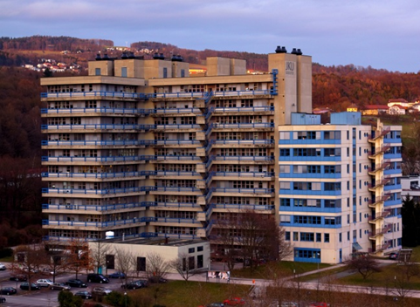

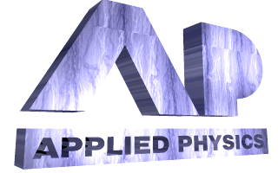
Electrodynamic description of a spaser: shape, size, multipolar modes,
and threshold minimization
Nikita Arnold, Calin Hrelescu, Thomas A. Klar
Institute of Applied Physics, Johannes Kepler University, Linz, Austria

Slide 2
Spaser: nanoscale light generator
Benefits: sub-λ resolution, field enhancement, MMs, NL effects, sensors
Bergman, D. J. and M. I. Stockman (2003). "Surface plasmon amplification by stimulated emission of radiation: quantum generation of coherent surface plasmons in nanosystems." PRL 90(2): 027402.
Stockman, M. I. (2010). "The spaser as a nanoscale quantum generator and ultrafast amplifier." Journal of Optics 12(2): 024004
Noginov, M. A., G. Zhu, et al. (2009). "Demonstration of a spaser-based nanolaser." Nature 460(7259): 1110-U1168.
Oulton, R. F., V. J. Sorger, et al. (2009). "Plasmon lasers at deep subwavelength scale." Nature 461(7264): 629-632. Not 3D
Notes:
SPASER: Surface Plasmon Amplification by Stimulated Emission of Radiation. I should not explain what is spaser in this audience. Here are just several historical examples.

Slide 3
Motivation: Spaser for pedestrians
Laser is QM system, but can be understood classically:
ε”<0 or n”<0 (threshold)
ε(E²) saturation, which determines CW output
Do the same for spaser
Didactical value, experimental guidelines
Minimize threshold choosing the best mode and NP shape
This is scattered through the literature

Slide 4
Universal thresholds for Ag and Au
Recipe
Choose λ with low -ε”_{M}/ε’_{M} (usually IR)
Keep host ε’_{G} small
Choose geometry and mode according to N (usually <0.1=“thin”)
Keep structure small to avoid retardation, or use multipoles
Use Ag rather than Au
Notes:
These are all quasi-static results. N controls the “M/G ratio”. N=0.5 for a sphere.
UV: ε’_{M} not “metallic” enough IR: Metal losses too high

Slide 5
Spherical metal dipole
Spherical gain dipole
It takes two to tango
2 coupled dipoles
Losses
Amplifier;
not a generator
Similar to FP laser, Generator: D→0, for laser, T→∞
0(noise)×∞(T) = finite output
G, L are matrices ⇒ eigenvalues Λ
If round trip L_{Λ}=1, p→∞, or p≠0 for E^{i}=0
Notes:
Similar for other quantities
Reasonable exposition of CDA or DDA
Bowen, P. T., T. Driscoll, et al. (2012). "Using a discrete dipole approximation to predict complete scattering of complicated metamaterials." New Journal of Physics 14: 033038.

Slide 6
2 small spherical dipoles in the near field
R
a₂
a₁
y
x
z
Effective polarizability in z direction (largest, dipoles → →):
Coupling δ<<1 ⇒ high threshold
For “overlapping” structures (like core shells) effective δ is larger
D=0 at threshold ⇒ find gain ε”₂ and ω
Notes:
Can be applied to several particles, but math is more complex

Slide 7
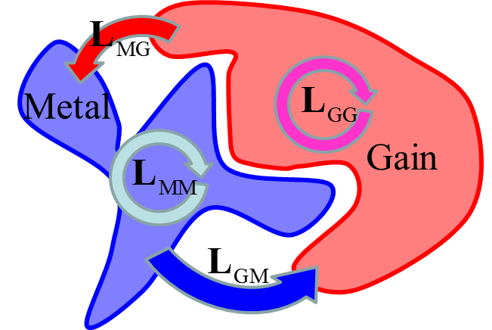
Continuous case. Fields are vector functions, L is an operator
Volume Integral Equation for EM fields. Operator feedback loop
Threshold: largest eigenvalue of L, Λ(gain,ω)=1
Eigenvector E_{Λ} defines the field structure, near threshold E∝(E_{Λ}.E^{i})
Saturation: Δε(r,⎢E⎪²), non-linear, but similar
Post-threshold fields and ω from self-consistency for E^{i}=0
As for 2 dipoles; α_{M}→(I-L_{MM})⁻¹, G₂₁ → L_{GM}
G and M should mutually excite good modes with the right phase
de Lasson, J. R., J. Mork, et al. (2013). "Three-dimensional integral equation approach to light scattering, extinction cross sections, local density of states, and quasi-normal modes." Journal of the Optical Society of America B-Optical Physics 30(7): 1996-2007.
Novotny, L. and B. Hecht (2012). Principles of nano-optics. Cambridge, Cambridge University Press.
Notes:
Integration over ε≠1 regions. G is a dipole field

Slide 8
Multipole denominators for cross-sections
D”
Generation threshold: D=0
Problem: not enough gain
Can one lower threshold?
Can dipole mode be not the best?
What is the optimal geometry?
Best mode?
resonance and
its spectral width
D(ω)
gain ↑
D’
Notes:
It is difficult to solve integral equations.
More accurately, index l numbers eigenfunctions (e.g., azimuthal and radial numbers) rather than multipoles, but we will not dwell on this. In this work almost always they will be only multipoles
f and g also depend on ε-s, shape and size, with leading term O(k)

Slide 9
Small Metal NP in gain and gain cavity in metal
Gain
Metal
Metal
Gain
Gain ordering of multipolar thresholds is reversed
For small active cavity, dipole mode is the last to generate
Notes:
Quasi-static denominators determine spectral positions and threshold gain :

Slide 10
Core-Shell = particle + cavity
What will generate first? Quasi-static CS denominator:
Symmetric gain ε₁=ε₃, GMG (Gain-Metal-Gain)
Thin shell h₂<<a₁. Thresholds can be very low:
ε₃
Dipole l=1 generates first
Applicability narrow ⇒ Use retarded
multi-shell-Mie
ε₃=ε₁
Gain
ε₂
ε₂
ε₁
a₂
ε₁
a₁
a₁
h₂
Core
h₂
Quinten, M. (2011). Optical properties of nanoparticle systems : Mie and beyond. Weinheim, Germany, Wiley-VCH.
Raschke, G. (2005). Molekulare Erkennung mit einzelnen Gold–Nanopartikeln. PhD, Ludwig–Maximilians–Universität.
Gain
Shell
Metal
Ambient
Notes:
Hybridization: 2 solutions close to those for core only with ε₂=ε_{1,3}

Slide 11
Symmetric GMG (gain-metal-gain) CS (core-shell).
Core and ambient: ε₁₌₃=2.6-iε”₁₌₃, Shell: Ag_{JC}. Dipole mode l=1.
Notes:
Log scale for gain. For large cores no Ag_{JC} data in the IR, higher losses

Slide 12
Symmetric GMG (gain-metal-gain) CS (core-shell).
Core and ambient: ε₁₌₃=2.6-iε”₁₌₃, Shell: Ag_{JC}. Quadrupole mode l=2.

Slide 13
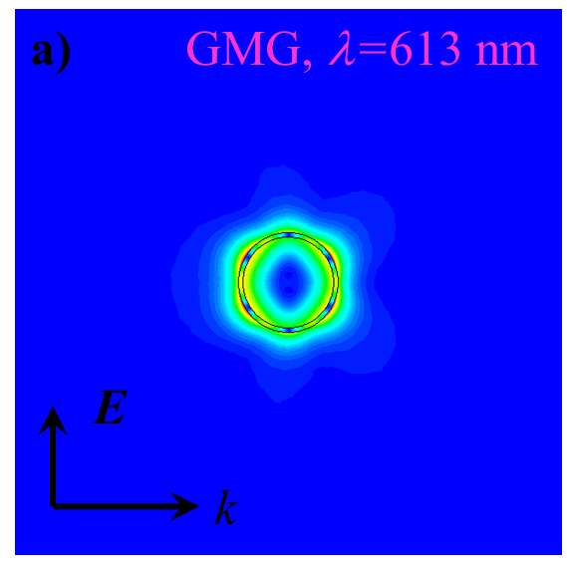
Symmetric GMG (gain-metal-gain) CS (core-shell).
Core and ambient: ε₁₌₃=2.6-iε”₁₌₃, Shell: Ag_{JC}. Hexapole mode l=3.

Slide 14
Symmetric GMG (gain-metal-gain) CS (core-shell).
Core and ambient: ε₁₌₃=2.6-iε”₁₌₃, Shell: Ag_{JC}. Octupole mode l=4.

Slide 15
Symmetric GMG (gain-metal-gain) CS (core-shell).
Core and ambient: ε₁₌₃=2.6-iε”₁₌₃, Shell: Ag_{JC}. Decapole mode l=5.

Slide 16
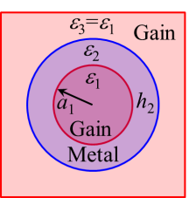
Core-Shell Summary
Small h, a: ε_{G}”, λ depend on h/a only
Retardation starts later for higher l, and increases threshold
All l have the same -ε_{G}”_{min}~0.026 (realistic!);
700<λ<1100 nm, at different
optimal h,a (small for dipole)
For a given geometry, the lowest threshold is often not dipolar. For a₁=100, h₂=5 it is octupole, l=4!
Notes:
Bonding, charge-symmetric long-wavelength hybridization modes of CS with lower field in the metal, and lower absorption
Torus probably has 2 “good” axes with r/R dependence close to that of prolate spheroid. Isotropy is good for experiments

Slide 17
Metal spheroids in gain. Dipolar modes
Easier way to get low thresholds.
Rotational semi-axis c (z), a=b (x,y); depolarization factors L
E
ε₂
ε₁
a=b
c
prolate
ε₂
c
E
ε₁
a=b
oblate
Small thresholds for E along bigger axis
Notes:
Unlike CS, spheroids are anisotropic. Prolate spheroid has 1, and prolate 2 “good” axes. CS has 3, and is isotropic (good for experiments).

Slide 18
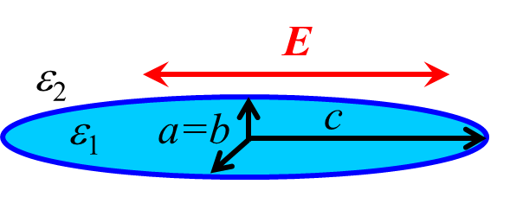
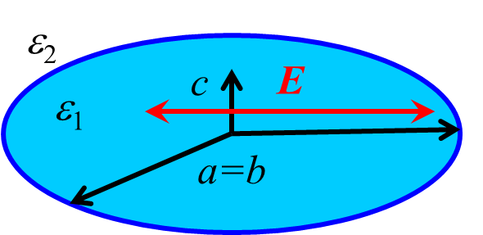
Dipolar thresholds for Ag spheroids
size
Thresholds ↑ with size
due to radiative losses
As for CS:
-ε”_{G,min}~0.026, 700<λ<1100
Prolate, oblate and CS are all similar
size
Retardation from:
Kuwata, H., H. Tamaru, et al. (2003). "Resonant light scattering from metal nanoparticles: Practical analysis beyond Rayleigh approximation." APL 83(22): 4625-4627. Moroz, A. (2009). "Depolarization field of spheroidal particles." JOSA B 26(3): 517-527.
Notes:
Kuwata (dashed) and Moroz (dotted) are similar ⇒ consistent

Slide 19
Universal quasi-static threshold
Multipolar(!) thresholds of different(!) shapes rescale into each other. Why?
Separate Re, Im, exclude N
Consequences:
Particles with the same N have the same λ_{thr} and gain ε_{G}”
Different multipoles l, with N_{l1}=N_{l2} have the same λ_{thr} and gain ε_{G}”
Factor N(shape,l) is non-trivial, but can be obtained numerically
Smuk, A. Y. and N. M. Lawandy (2006). "Spheroidal particle plasmons in amplifying media." Appl. Phys. B 84(1-2): 125-129.
Wang, F. and Y. R. Shen (2006). "General properties of local plasmons in metal nanostructures." PRL 97(20): 206806.
Notes:
Smuk is for spheroidal dipoles only. Wang does not discuss spasing at all. No shape and multipole discussion
The more general the statement, the simpler it is. This is already close to Feynman’s F=0 formula which explains everything ☺

Slide 20
Universal thresholds for Ag and Au
Recipe
Choose λ with low -ε”_{M}/ε’_{M} (usually IR)
Keep host ε’_{G} small
Choose geometry and mode according to N (usually <0.1=“thin”)
Keep structure small to avoid retardation, or use multipoles
Use Ag rather than Au
Notes:
These are all quasi-static results. N controls the “M/G ratio”. N=0.5 for a sphere.
UV: ε’_{M} not “metallic” enough IR: Metal losses too high

Slide 21
Best conditions for Drude metal
Have results for polar crystals as well
Lorentzian gain ε_{L}L(ω-ω_{L}) with detuning δ
N-condition = spaser frequency. Cold γ_{res} and threshold both depend on the balance between the ε”_{M} and (ε’_{M})_{ω}⇒
This classically reproduces QM result:
Typically, gain ε_{L}(δ ≤1) is 30-50% higher, than ε_{L}(δ =0)
Stockman, M. I. (2010). "The spaser as a nanoscale quantum generator and ultrafast amplifier." Journal of Optics 12(2): 024004
Notes:
Drude is in semi-quantitative agreement with real JC data
For polar crystals (polaritons, instead of plasmons for metals), on the wings of the absorption line, the results are worse
Dependence on ε∞ may make TiN favorable

Slide 22
Can 3 (or more) materials decrease threshold? No!
General core-shell – non-trivial example with 3 materials.
ε₁+Λε₃ plays the role of compound gain
Best is: ε”_{1,3} larger, ε’_{1,3} smaller
⇒ symmetric CS
Can double-NP near field antennas decrease threshold? No!
c
ε_{G}
E
ε_{M}
a=b
ε_{M}
R
The same ε_{G}~ε_{M} relation.
For a given shape L, v makes N_{eff}<N, red shifts the resonance
But as N sweeps all values, the universal optimum remains the same
Notes:
Argument: total internal reflection. CS is isotropic. As usual, these are quasi-static results. One can quickly study the cases ε_{1,3}>>1, etc. They are impossible because of “+”=“-” relation. One can make it even more rigorous with more algebra fully resolving for ε”_{1,2,3} and assuming that δ<<1.

Slide 23
2nd hybrid mode of core-shell, with short λ
ε₁₌₃=2.6-iε”₁₌₃, ε₂(shell)=Ag_{JC}. Quadrupole l=2. Higher thresholds.
Threshold decreases for large spheres and thick shells!
Notes:
Let us have a look what is going on where the arrow points.
This is charge anti-symmetric anti-bonding mode. It typically has stronger field in metal and stronger absorption.
Charge-symmetric bonding hybrid plasmonic mode (Park and Nordlander 2009) has lower energy (longer wavelength). Due to synchronization of charges on the inner and outer sides of the shell, this mode has lower field inside the metal, which further decreases absorption.
Fig. A2. Quadrupolar (l=2) threshold for the high-energy (short wavelength, high absorption) core-shell hybrid mode. The geometry, parameters and notations are the same as in Fig. 3. For presentational purposes, the scaling of contour intervals in both panels is logarithmic. The relationship between ε”_{thr} and λ_{thr} differs from that in Fig. 3 due to different structure of the denominator.

Slide 24
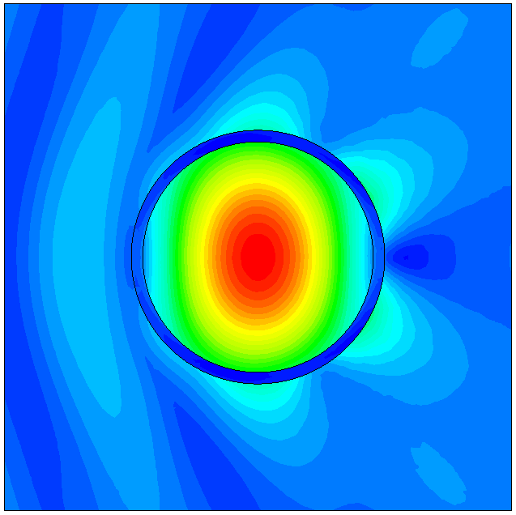
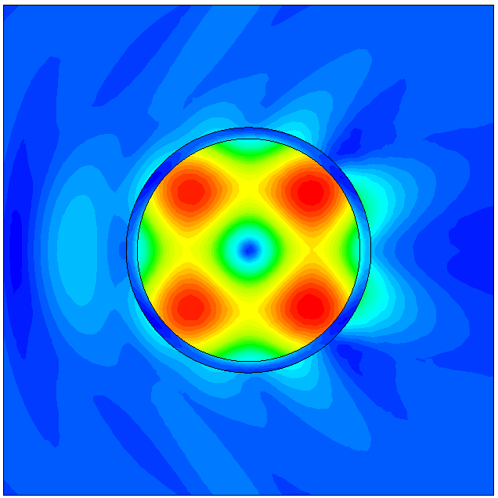
This is different dependence on a-h. It violates ε_{G}”(λ_{thr}) relation and universal minimal threshold condition. What is this?
λ=1230 nm
λ=898 nm
a=300 nm, h=30 nm
ε”_{G}=0.06 (~ l=1,2 thresholds)
It is not near field
Similar in:
Pan, J.; Chen, Z.; Chen, J.; Zhan, P.; Tang, C. J.; Wang, Z. L., Optics Letters 2012, 37, 1181-1183
Notes:
It violates ε_{G}”(λ_{thr}) relation EXACTLY because it is not near field.

Slide 25
Mie modes of large void with gain in metal have low thresholds
It is metal + gain,
It has very low -ε_{G}”
but it is NOT a spaser
It is small, spherical,
“far-field” laser
Metal background replaces scattering by absorption
-ε_{G}”~n_{G}^{’-1}(vacuum)→10⁻³(metal), a~0.3-0.5 μm (but not smaller!)
-ε_{G}”~(ka)⁻¹ (loss/gain ~ area/volume). It is arbitrarily low for higher radial modes near “good” λ.
Notes:
Magnetic modes are similar

Slide 26
Saturation broadening in gain medium
Metal-gain coupled dipoles.
Nonlinear equation have solutions for E_{G} without external field, E^{i}=0
R
a_{G}
a_{M}
y
x
Near-field spheres
metal
gain
z
⇒Find ω(ε_{L}) and s(ε_{L})
Boyd, R. W. (2008). Nonlinear optics. Amsterdam ; Boston, Academic Press.
Novotny, L. and B. Hecht (2012). Principles of nano-optics. Cambridge, Cambridge University Press.
Notes:
For small spheres local field acting on a chromophore within the sphere, is the external field acting on a sphere, i.e., exactly E₂
In some sense system “remains on threshold”.

Slide 27
2-dipoles spaser above threshold
coupling δ
ε_{thr} ↓, slope ↑ with δ ↑
ε₁’(λ)≈-2 (dimer ≈ MNP resonance)
λ, ε_{thr}, slope - all depend on δ, λ_{L} , γ_{L}
but λ =const(ε_{L}), saturation s∝ε_{L}-ε_{thr} Why?
Notes:
Everything is along z. For spheres δ<1/16, but we relax this requirement. It is roughly equivalent to smaller metal losses. THESE coupling and ε_{L} numbers are actually unrealistic.

Slide 28
At threshold pumping ε_{thr}, the solution is ω_{thr}, s=0
Which (ω, s) can keep D=0?
Above threshold ε_{L}>ε_{thr}. This allows p≠0 with E^{i}=0
Take
and s such, that
We know it!
Saturated gain above threshold = full gain at threshold
For Lorentzian gain:
This works if s=const(r).
E.g., cores of CS ellipsoids
in quasi-static dipolar modes
Baranov, D. G., E. S. Andrianov, et al. (2013). "Exactly solvable toy model for surface plasmon amplification by stimulated emission of radiation." Optics Express 21(9): 10779-10791.
In general, s(r) ⇒ complicated math
Notes:
Physics – energy balance. Already quasi-static multipoles are difficult. This is more complex than it seems, as one first has to find ε_{thr} and ω_{thr}

Slide 29
Conclusions
CW spaser can be described by classical ED
Different MNPs and multipoles have the same thresholds if they have the same N(shape, l)
For Ag in PS, -ε”_{G}≈0.026 and 700<λ<1100 nm, C_{dye}>10¹⁹cm⁻³
Spheres and dipolar modes are often bad. Try thin spheroids and CS multipoles. Choose shape to optimize λ.
Outlook
r, t-dependent saturation, pumping, optical properties ⇒
same concepts, numerics.
Difficulties (small structures)
Parameters differ (boundary losses, quenching, Purcell, etc.)
High C_{dye} ⇒ chromophore aggregation ⇒ smaller inversion
Manufacturing, poor wetting, oxides, roughness
Notes:
N roughly defines metal/gain ratio. We are talking about non-retarded small particles here

Slide 30
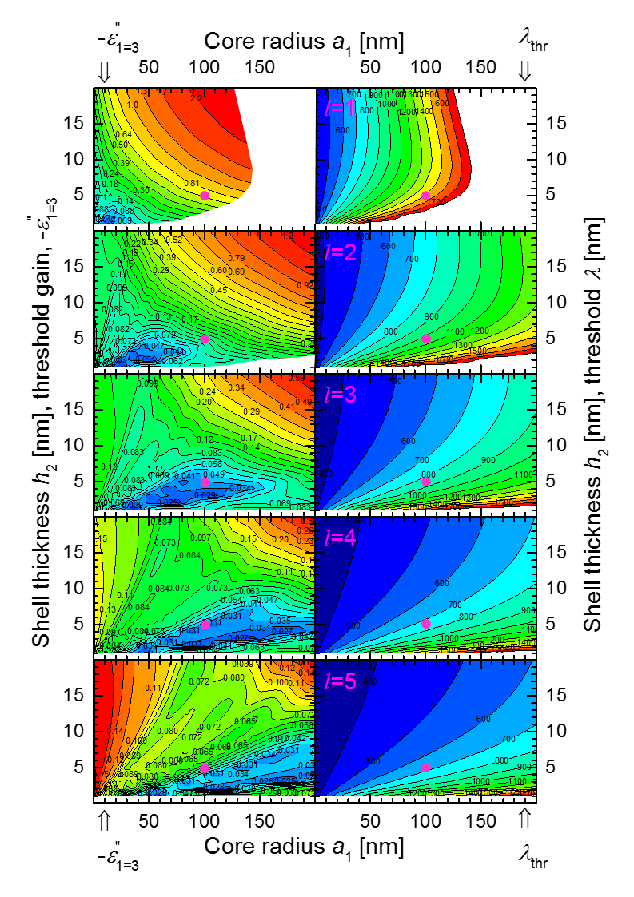
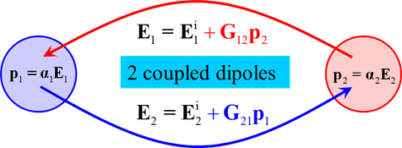
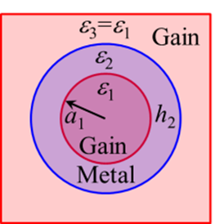
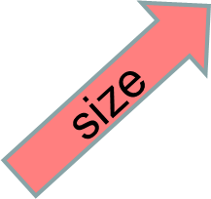

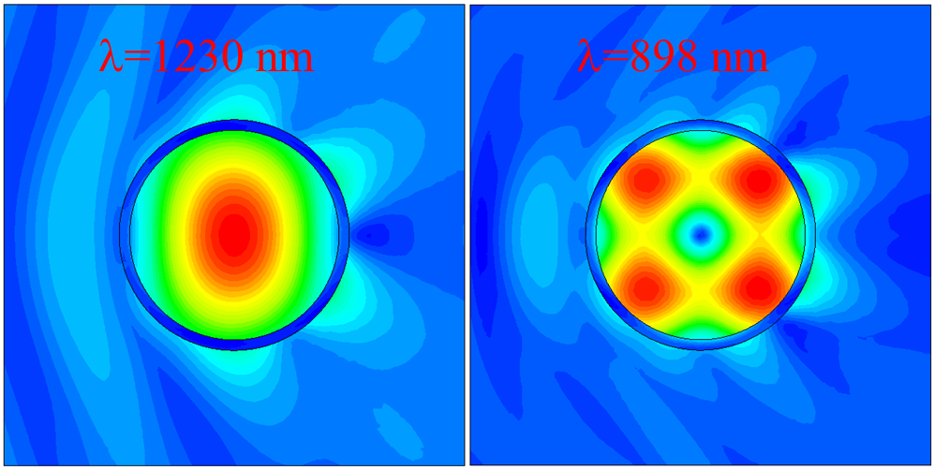
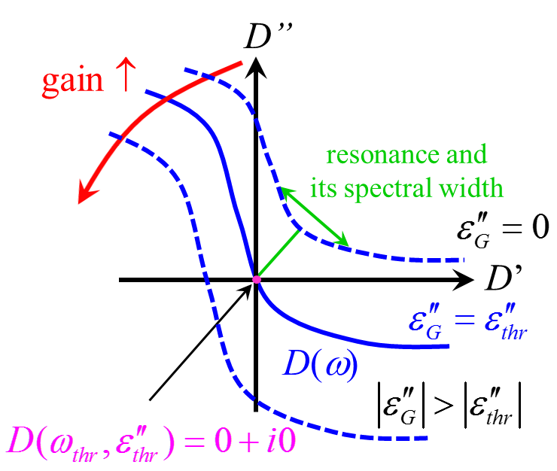
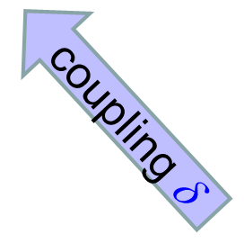


Thank you for your attention
Funding: European Research Council (ERC Starting Grant 257158 ”Active NP”)
Notes:
I hope that this will help you to teach about Spasers in the general physics course. And this is a graphical summary that should inspire you to ask questions. I have shown that coupled dipoles are a good test model for spaser, shown how to optimize geometry to decrease threshold for spheroids and CS, discussed universal optimum, large laser, but not spaser spheres and some general post-threshold features.

