Slide 1
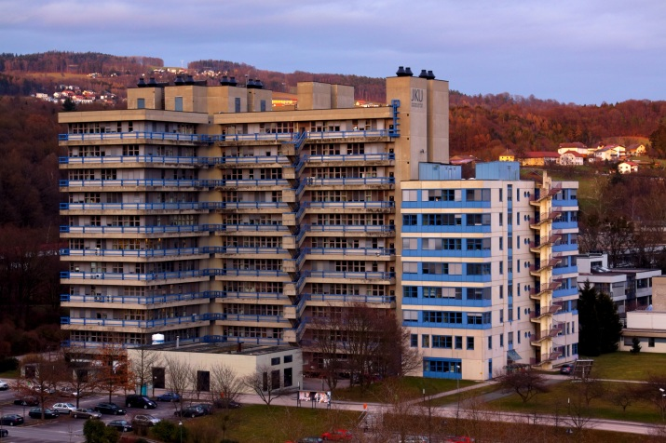
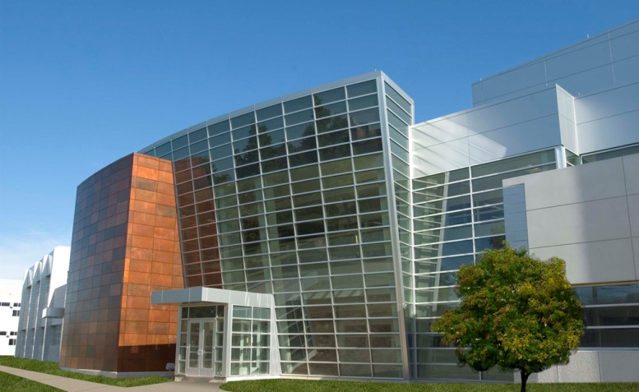
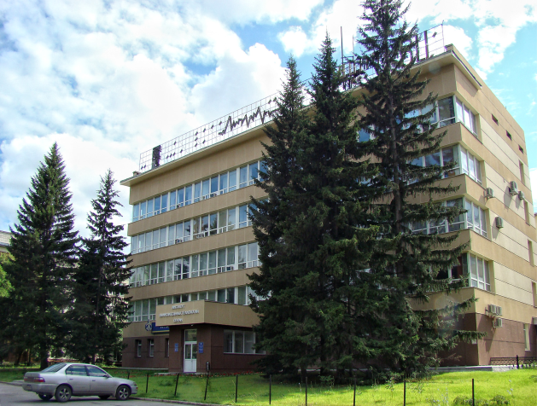
Experiment-fit time-domain modeling of high-optical-gain dyes for active plasmonic nanostructures
Nikita Arnold¹, Ludmila Prokopeva^{2,3}, Thomas A. Klar¹, Alexander V. Kildishev²
¹ Institute of Applied Physics,
J. Kepler University, Linz, Austria
² Birck Nanotechnology Center,
School of ECE, Purdue University, USA
³ Institute for Computational Technologies, SB RAS,
Novosibirsk, Russia
Notes:
1

Slide 2
Why model dyes in nano-plasmonics?
2
Limiting factor: losses. Proposal: fight losses with gain¹
H
Experimental proof: high losses require high gain:
lossless fishnet with Rh800²
Silver
Al₂O₃
Gain material
X
Y
Aims of detailed modeling:
  Experiments, new physics, devices
Challenges:
  Dispersion, population dynamics
  Multiphysics: saturation, NL effects, e-phonons-T, phase changes, chemistry, etc. - all evolve in time
Numerical requirements:
  Unified description for dispersion and gain
  Algorithms: minimize flops, scalability, parallelization, stability, accuracy
  Applicable to FDTD (structured mesh), FVTD and FETD (shape-conformal unstructured meshes)
⇒Time domain
Numerical issues are scarcely addressed in literature^{3,4}
¹Klar, Kildishev, Drachev, Shalaev, IEEE J. of Sel. Top. in Quant. Electr. 12, 1106 (2006)
²Xiao, Drachev,Kildishev, Ni, Chettiar, Yuan, Shalaev, Nature 466, 735 (2010)
³Trieschmann , Xiao , Prokopeva, Drachev, Kildishev, Opt. Express 19(19) 18253 (2011)
⁴Prokopeva, Bornemann, Kildishev, IEEE Trans. Magn. 47(5), 1150 (2011)
Notes:
2
Limiting factor for almost any figure of merit in plasmonics and metamaterials – field enhancement, spatial localization, imaging

Slide 3
Dispersion: from a Pade approximant to physical terms
Frequency-Domain
Conductivity
Drude
Debye
Lorentz, Sellmeier, CP
  ε(ω) - arbitrary Pade
  Partial fraction decomposition
Time-Domain
  a_{j}– amplitude, φ_{j} – phase, δ_{j} –oscillation, γ_{j} – damping
Simple terms in p(t)=χ(τ)*E(t-τ) convolution are calculated recursively
Notes:
Pade – rational ratio
a, b coefficients real, as they stem from physics
δ(… ω ) irrelevant in some Fourier transforms as they are usually at unphysical ω, e.g., at ω=0, for conductivity term

Slide 4
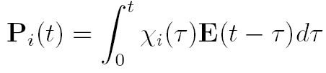






Dispersion: Universal time-domain implementation
Invert ε(ω) terms →
Auxiliary Differential Equations (ADE):
Drude, Debye, Lorentz, Sellmeier, Critical Point (CP)
Recursive Convolution (RC)
≈
χ^{n-k}E^{k} with χ^{k}=cχ^{k-1}
1
=
Different RC approx. lead to different FD schemes
Finite-Difference (FD) approximation
Similar FD Equations for both ADE and RC. 2-3 stencil, 2nd order
■ all Models in one framework
■ less parameters ■ less flops (>30%)
Dispersion section is published in IEEE Trans. Magn. (2011) 47-5
Notes:
Explain physics – Drude electron, Debye damping, Lorentz oscillator, etc. Hint how they appear from ε(ω) expressions
c – usually e^{β} - recursive accumulator. Different RC schemes depend on the approximations used in integration (of these simple functions) and differ in first 2 χ terms
PCRC – piecewise constant RC
PCRC2 – piecewise constant RC of the second order
PLRC – piecewise linear RC
TRC – trapezoidal RC
RRC – rectangular RC
4

Slide 5
From dispersion to gain
Lorentzian example: 4 level scheme for Rh800
Polarizations:
Lorentz oscillators with N(t)
3
γ₃₂~0.3ps
pumping, K₃₀ ~29ns
695 nm, Γ₃₀~9fs
2
lasing, K₂₁~6.3ns
723 nm, Γ₂₁~3.75fs
γ_{nr21}~262ps
γ_{r21}~6.3ns
Full p-N
system
1
Populations dynamics
0
γ₁₀~0.35ps
Fast driving terms
(energy exchange)
Full p-N: Siegman, Lasers, (1986);
DM: Rautian, Shalagin, Kinetic Problems of Nonlinear Spectroscopy (1991) AND Boyd, Nonlinear Optics (2008);
Polarizations are coupled to Maxwell’s equations
Notes:
ADE-FDTD: Zhukovsky and Chigrin, Phys. Stat. Sol. 244, 3515 (2007)
(Yee’s scheme)
5

Slide 6
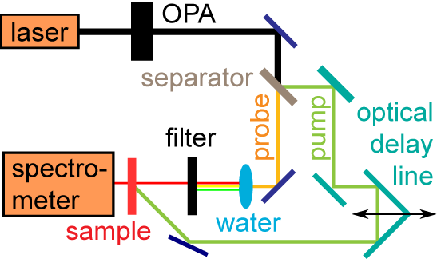
Parameters retrieval for gain medium¹
Experiment: dependence of probe transmission on pump intensity
Rh800 in epoxy solid film. No literature values (only e.g., methanol host²)
Pump-probe:
Different λ_{probe} (703…726nm)
Different τ_{pulse} (103fs, 2ps)
Rh800/ethanol reference for quantum yield η
Simulations: 4-level p-N scheme
+ 1D Maxwell
Different pulse durations (time dynamics)
Different wavelengths (spectral behavior)
RMS fitting for λ_{probe}=720nm ⇒ model parameters
Key parameter: τ_{r,21}+ measured η
τ_{pulse}=2ps
λ_{pump}=695nm
λ_{probe}=720nm
Result: All parameters are close to methanol values, apart from ⇒
Chemical environment affects NR lifetimes
τ_{nr,21}
0.26ns
τ_{nr,21}²
0.77ns
¹Trieschmann , Xiao , Prokopeva, Drachev, Kildishev, Opt. Express 19(19) 18253 (2011)
²D. P. Benfey et al., “Diode-pumped dye laser analysis and design”, Applied Optics 31, 7034 (1992)
Notes:
Two curves are with and without Γ term in population equations
Host is important as it influences kinetic dye parameters
Water creates white light that is used only in probe before the filter (it has low intensity)
Intensity scale was effectively fitted in calculations as it is difficult to directly measure it, especially inside the gain medium
One can argue about the absolute amplification, but the signal was definitely enhanced with respect to “no pump” case
Probably dye was to thin for strong effect
There is competing absorption tail on the emission lime, also FP and other 1D effects
6

Slide 7
Levels of description:
QM: (ψ or ρ), Full p-N, SVEA, Rate equations, ε(ω)
Energy exchange
Complex SVEs
Full p-N
SVEs
Rate
SVEA
SVEA: average over T_{light}, always works,
is ~10¹⁻² times faster
Lorentzian absorption/emission
Rate equations: fail for short pulses, coherent effects
Notes:
7
Analytic signal from the field of signal processing
For CARS all frequencies important

Slide 8
Examples of Rh800 dynamics and χ(ω) recovery
τ=10fs, λ_{30abs}=695nm
0.02
Polarizabilities
0.01
E=10⁸V/m - “weak” field
Real
0
gain
3
0
analytical
-0.01
-0.02
0.04
0.03
Lorentzian
χ”₃₀ absorption
Imag
0.02
0.01
0
650
660
670
680
690
700
710
720
730
740
750
wavelength, nm
0.02
Polarizabilities
E=10⁹V/m
0.01
30 saturation
Real
0
-0.01
gain
3
0
-0.02
analytical
post-pulse 21 inversion
0.04
0.03
χ”₃₀ saturates
Imag
0.02
0.01
0
650
660
670
680
690
700
710
720
730
740
750
wavelength, nm
Notes:
8

Slide 9
Coherent effects for 30 transition in Rh800
τ=50fs, λ_{30abs}=695nm
E=10⁹V/m (I=2.2×10¹¹W/cm²)
3
γ₃₂~0.3ps
pumping, K₃₀ ~29ns
695 nm, Γ₃₀~9fs
2
lasing, K₂₁~6.3ns
723 nm, Γ₂₁~3.75fs
γ_{nr20}~262ps
γ_{r21}~6.3ns
1
0
γ₁₀~0.35ps
Rabi terms
Coherent 30
inversion
32 relaxation
21 inversion
Notes:
9
3-2-1 relaxation after the pulse
Appreciable susceptibility – see previous slides
P in SI units, χ=P/E0ε0, ε0=8,8×10⁻¹²

Slide 10
All 4 levels are needed to describe high-I absorption
10
3
γ₃₂~0.3ps
Rh800, τ=1ps, λ_{30abs}=695nm
E=10⁹V/m (I=2.2×10¹¹W/cm²)
pumping, K₃₀ ~29ns
695 nm, Γ₃₀~9fs
2
lasing, K₂₁~6.3ns
723 nm, Γ₂₁~3.75fs
γ_{nr20}~262ps
γ_{r21}~6.3ns
Transition 30:
at resonance, saturated
Transition 21:
off-resonance, inverted,
p₂₁(ω=ω₃₀) has phase shift
Total p=p₃₀+p₂₁<p_{30,21}
1
0
γ₁₀~0.35ps
1
N
3
0.27
N
3
0.8
N
2
N
2
N
1
0.26
N
1
0.6
N
0
N
0
0.25
0.4
0.24
0.2
0
0.23
×10⁻⁶
0
1
2
3
4
5
6
7
3.465
-6
3.47
3.475
3.48
t, ps
3.485
3.49
3.495
3.5
3
x 10
-5
t, ps
4
x 10
P
3
P
2
1
2
when 30 is saturated
p₂₁(ω₃₀)>p₃₀
2
1
P
P
3
0
2
3
0
1
sum
1
sum
0
0
-1
-1
-2
-2
-3
-3
-4
t, ps
0
1
2
3
4
5
6
7
3.465
3.47
3.475
3.48
3.485
3.49
3.495
3.5
Notes:
10

Slide 11
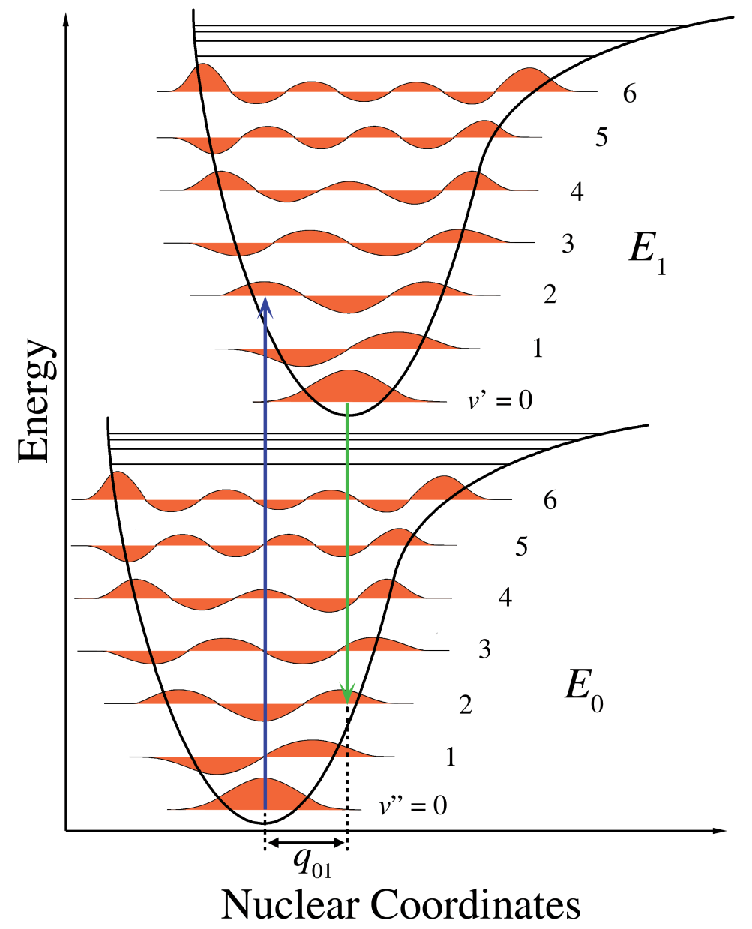
Complex dyes: beyond single Lorentzian
11
Asymmetric Lorentzians (CP models), virtual levels for MP absorption¹
Realistic models should include:
N(t)-saturation, coherent effects (Rabi)
Multilevels, vibronic sub-lines with spectral “mirroring”
Which γ to keep? Physics: non-radiative relaxations to vibronic bottoms, radiative “vertical”
3₂
3₁
γ₃₂
2
lasing
K₂₁₍₁₎,K₂₁₍₂₎
pumping
K₃₍₁₎₀, K₃₍₂₎₀
γ_{nr20}
1₂
1₁
γ₁₀
Do we need such details?
To pinpoint plasmonic resonances
To quantify modifications of dye parameters by metals (Purcell effect, etc.)
0
¹SPIE Proc. (2011) 8172-10
Notes:
11
1-Bilinear numerical scheme for improved stability
The corresponding tools will be added to nanohub.org

Slide 12
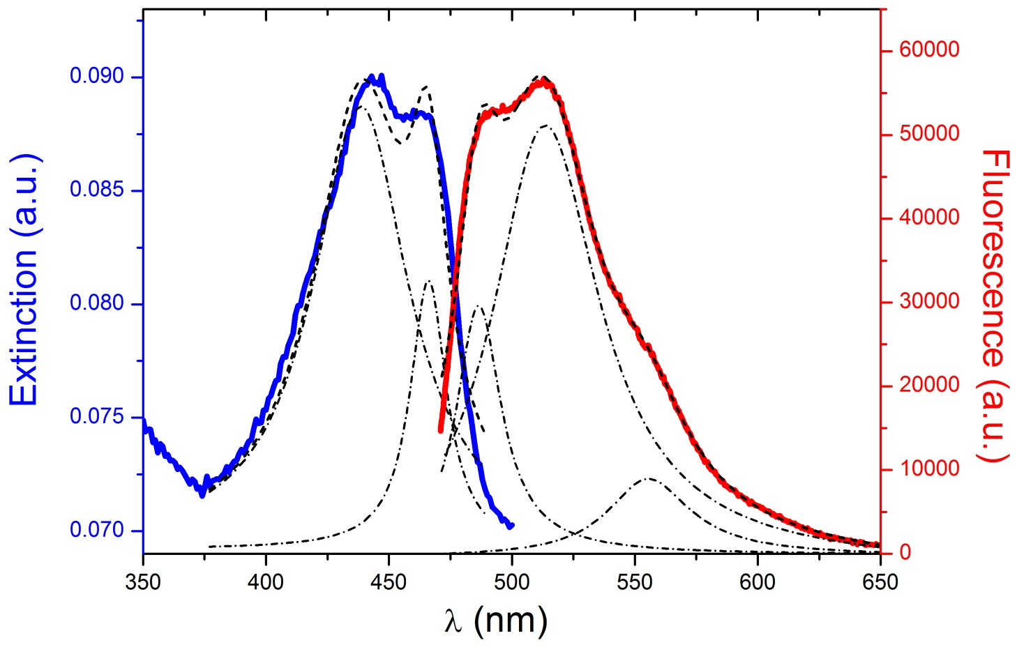
6-level scheme example:
“Thermo Scientific Green Fluorescent Dye” in PS film
12
λ=438
1
513
1
466
0.61
486
0.59
Γ_{HWHM}
4.7, 12fs
Γ_{HWHM}
11, 5.3, 8fs
555
0.17
3₂
3₁
γ_{r3(1)0}, K₃₍₁₎₀~55ns, 466nm
pumping
γ₃₂~1ps
γ_{r3(2)0}, K₃₍₂₎₀~13ns, 438nm
2
K₂₁₍₁₎~84ns, 486nm
lasing
K₂₁₍₂₎~23ns, 513nm
γ_{nr20}~2.9ns
γ_{r21(1)}~84ns
Experiment (Dr. B. Ding): τ_{fluor} = 2.53ns,
σ_{abs} ≈10⁻¹⁶cm², η=0.14, n“=0.01 (OD @2λ), α=2.3×10³ cm⁻¹, N_{tot}=2.3 ×10¹⁹ cm⁻³
γ_{r21(2)}~23ns
1₂
1₁
0
γ₁₀~1ps
Notes:
12

Slide 13
χ(ω),ε(ω)-recovery for 6 level scheme. 3fs pump-probe pulses
0.015
χ’
Polarizabilities
0.2
N3
2
0.01
0.15
N3
1
τ_{del}=2ps
N2
Real
0.005
0.1
N1
2
0
χ<χ_{analyt} -saturation
0.05
N1
1
-0.005
0
N0
-0.01
0
-4
0.5
1
t, ps
1.5
2
2.5
0.02
2
x 10
pump
λ3₂0=438nm
2×10⁹ V/m
sum
0.015
sum
1
P3
2
0
gain3
2
0
0
P3
0
Imag
0.01
χ”
gain3
1
0
1
0.005
analytical
-1
P21
2
-2
P21
1
0
0
-5
0.5
1
t, ps
1.5
2
2.5
400
420
440
460
480
500
520
540
560
580
600
5
x 10
wavelength, nm
χ’
Polarizabilities
λ21₂=513nm
10⁹ V/m
0.002
0
0.001
probe
Real
0
-5
-0.001
2
2.005
2.01
2.015
2.02
2.025
2.03
2.035
2.04
2.045
-0.002
Fine spectral structure
All polarizations (lines overlap) ⇒ recover separate terms
Frequency scan for longer pulses
0
-0.001
sum
χ”<0
-inversion
Imag
-0.002
gain21
2
-0.003
gain21
1
-0.004
400
420
440
460
480
500
520
540
560
580
600
wavelength, nm
Notes:
13
When pump saturates, probe signal is clearer
There exist numerical problems, short pulses, stability, etc. – they are all resolved

Slide 14
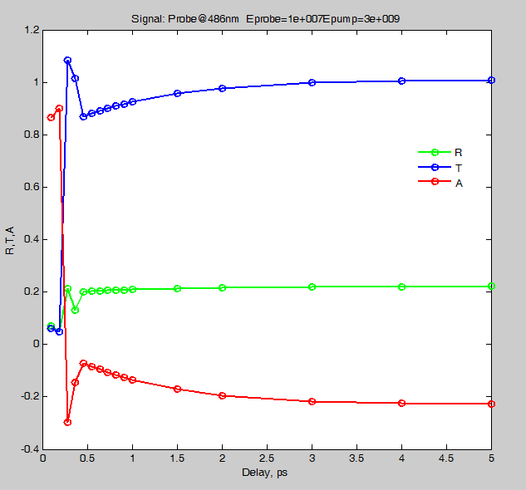
6 level scheme, 4μm slab. Full p-N+1D Maxwell, τ_{pulse}=50 fs
Probe R, T, A as a function of pump-probe delay
Pump: E=3×10⁹V/m, λ_{pump}=438nm (main line), Probe: E=10⁷V/m
τ_{delay} dependence reflects relaxation times τ_{3(1,2)2}=1ps
Both emission sub-lines are inverted (A<0), but:
T(513) is amplified (T>1), while T(486) is only enhanced (T>T_{no pump)}
For ns τ_{delay} the depopulation of upper emission level 2 settles in
λ_{probe}=486nm
weaker line
λ_{probe}=513nm
main line
Notes:
14
At longer, ns range times one can see depopulation of the upper emission level
τ₂=(γ_{r21(1)}+γ_{r21(2)}+γ_{nr20})⁻¹

Slide 15
6 level scheme, 4μm slab. Full p-N+1D Maxwell, τ_{pulse}=50 fs
Probe R, T, A as a function of pump intensity
Pump: 10⁹<E<10¹⁰V/m (λ_{pump}=438nm), τ_{delay}=5ps, Probe: E=10⁷V/m
Fabry-Perot and other 1D effects are important in R,T,A(λ)
T(513) is inverted (A<0) and amplified (T>1) at lower E_{pump} than T(486): 486nm is weaker and has stronger absorption overlap
E_{pump} dependence reflects saturation fluence
for 3₂0 absorption:
λ_{probe}=513nm
main line
λ_{probe}=486nm
weaker line
Notes:
15
Saturation intensity with τ_{relax} (probably τ₃₂ in this case – have a look in SVEA) instead of τ_{pulse} for longer pulses

Slide 16
Summary
Unified numerical modeling of dispersive media
Dispersion
IEEE Trans. Magn. (2011) 47-5
Unified modeling of gain media
- parameter retrieval for gain media
- asymmetric Lorentzian line shapes
- arbitrary multilevel (ML) schemes
Opt. Express (2011) 19(19):18253-9
Gain I
SPIE Proc. (2011) 8172-10
Description levels: Full p-N system, SVEA, Rate eqns., coherent and ML effects
6-level system example: ε(ω)-recovery, pump-probe transmission dependence on τ_{delay}, E_{pump}
Not published
Gain II
Notes:
16

Slide 17

Funding: ERC grant Active NP 257158
ARO MURI award 50342-PH-MUR
ONR MURI grant N00014-10-1-0942
AFRL Materials and Manufacturing Directorate Applied Metamaterials Program
Thank you for your attention
Notes:
ERC European Reseach Council
ARO Army Reseach Office
ONR Office of Naval Research
MURI Multidisciplinary University Research Initiative
AFRL Air Force Research Laboratory
17

