Slide 1


THEORETICAL SUGGESTIONS
FOR THE IMPROVEMENT OF DRY LASER CLEANING
N. Arnold
Angewandte Physik, Johannes - Kepler - Universität
A-4040, Linz, Austria

Slide 2
Motivation and goals
DLC is simple but not very efficient
Theoretical understanding improved over the last years
Local damage hinders DLC
Discuss qualitative ideas that can help DLC
Summary:
Optimal absorption and pulse duration for damage-free DLC
Cleaning in high RH atmosphere
Cleaning by 1D laser-induced SAW

Slide 3
Optimal absorption length
and pulse duration for DLC
We want to clean small particles by DLC
Field enhancement → Local ablation → Damage
One should not heat more than T_{m}
One should make expansion larger ⇒ l_{α}↑
But not so large, that sound slows expansion
To decrease enhancement: r/λ↓ if r ↓ and λ↑
Convert these considerations into formulas

Slide 4
Smaller absorption, shorter pulses
or why Excimers are bad for DLC
For non-absorbing particles
Smaller substrate absorption (bigger l_{α}) is better
for damage-free cleaning
Why?
l_{α} larger ⇒ with the same surface temperature T_{s} < T_{melting} ,
expansion l∝ Tdz larger ⇒ larger cleaning-damage window
T_{s}<T_{m}
T(z)

Slide 5
Small particles are interesting
They are removed in the force regime ml/τ ²>F₀ ≡ 2πrϕ
If r<<λ , they weakly disturb the local field (small dipole moment)
Even if they do, l_{3D} < l_{1D} for equal parameters and T_{s}
At best, maximum expansion till surface melting l_{max} ≈β₁ΔT_{m}(l_{α}+l_{T})
Force threshold written for l:
Almost universal constant
←Sizes that can be removed
ϕ - work of adhesion per area

Slide 6
Excimer
l_{α}=10 nm
in µm, ns:
Q-switch
l_{α}=100 µm
τ =100 ps
l_{α}=1 µm
c-Si:
l_{α}(193,248,308)≈5-10 nm
l_{α}(1.06) ≈ 200 µm→50 nm
l_{α}(2.94) ≈ 500 cm→30 µm
(depending on doping and T)
l_{α}(10.6) ≈ 1000 µm→100 nm
Try Er or other IR with τ <1 ns
r/λ is also better for IR
Experiments with Nd:YAG – still damage.
Talk of Prof. Bäuerle and poster of G. Schrems

Slide 7
Cleaning in vapor atmosphere
Steam laser cleaning:
Explosive evaporation of thin layer of liquid
Removes small particles, but:
poor reproducibility
Spin-on, film inhomogeneities
film unstable - evaporates, difficult to control,
synchronization with the laser pulse
Contaminates all surface
Kelvin
Radius R_{K}
Use capillary condensation
occurs below 100% relative humidity (RH)
stable liquid meniscus
liquid is only where it is needed

Slide 8
Capillary condensation
Liquid volume (wetting)
r
Liquid-particle surface
V_{l}
S₁
R_{K}
Capillary adhesion force
Independent on RH
Meniscus is stable. Kelvin radius:
σ - surface tension, µ - molar weight
Notes:
Note linear dependence on r

Slide 9
Let us draw it in scale
RH=0.95, Kelvin radius R_{K}=10 nm
n=1.4
There is a difference between RH=0.95 and 0.99
r= 2.5 µm
r= 150 nm
RH=0.99 Kelvin radius R_{K}=50 nm
Note that:
Surface tension disappears near T_{c l}
water molecules in the interstice may
decrease adhesion by a factor of ~100
⇒Heating up to below T_{c l} may help
r= 50 nm
r= 150 nm
Notes:
One can think of a tricky mechanism: Water a) increases adhesion by adds capillary force b) decreases adhesion as such by decreasing work of adhesion by polar molecules. When everything is cold, adhesion is increased, via capillary. But as we heat near critical temperature, capillary contribution disappears due to vanishing surface tension and we are left with pure decrease of adhesion.

Slide 10

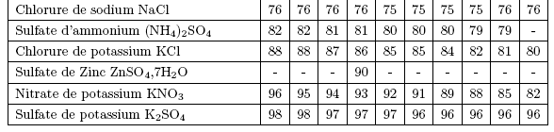
How to achieve stable high RH~1 : desired experimental setup
saturated salt, glycerol or sulfuric acid solutions*
hygrometer
laser
pulse
thermometer
entrance
window
barometer
valve
Also*: At 20 °C:
Pb(NO₃)₂ RH=98
CuSO₄.5H₂O RH=98
H₂SO₄:ρ 1.05→1, RH 97.5→1
thermostatic
reaction chamber
target
saturated salt, glycerol
or sulfuric acid solutions
Experiments with different setup, RH~95%:
Talk of Prof. Bäuerle and poster of G. Schrems
*From: F. Restagno, PhD thesis, Lyon, 2000
R. C. Weast. CRC Handbook of Chemstry and Physics

Slide 11
Cleaning with laser-excited
1D SAW (surface acoustic waves)
Advances in theory
SAW cleaning outside the beam
was demonstrated
Field enhancement →
Local ablation →
Damage
Difficult to modulate
No light – no damage
Interference→1D→
GHZ possible
Recovered
Resonant laser cleaning (RLC) idea

Slide 12
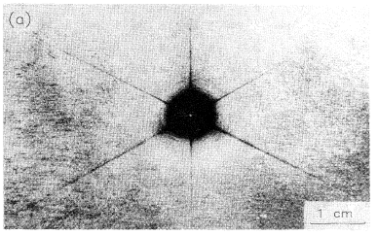
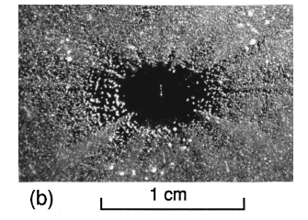
SAW cleaning with focused pulses*
1-2 µm Al₂O₃ on (111) Si, in air
Nd:YAG-1.06 µm, 10 ns,10 pulses
1-10 µm Al₂O₃ on (100) Si, in air
N₂-337 nm, 10 ns, 50 pulses
SAW wavelength is determined by the spot size ~ 15 µm
SAW is 2D and decays fast
SAW has 1-2 oscillations only
Cleaning of the particles outside of irradiated area, enhanced along the lines where SAW is stronger
*A. A. Kolomenskii, H. A. Schuessler, V. G. Mikhalevich, and A. A. Maznev, J. Appl. Phys., 84(5) 2404 (1998)
A. A. Kolomenskii, A. A. Maznev, Phys. Rev. B., 48(19) 14502 (1993)

Slide 13
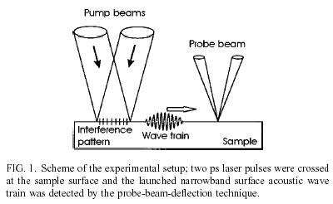
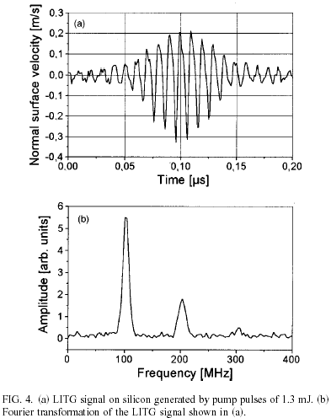
SAWs excited with
ps-pulse interference*
180 ps, THG Nd:YAG (335 nm), Si
100 MHz frequency θ=0.8° easily varied up to 1-10 GHz**
Many oscillations - resonance
1D propagation out of the beam area
No light – no damage
Non-linear effects, larger acceleration
Breakdown in air, universality
*A. Frass, A. Lomonosov, P. Hess, V. Gusev, J. Appl. Phys., 87(7) 3505 (2000)
**R. M. Slayton, K. A. Nelson, A. A. Maznev, J. Appl. Phys., 90(9) 4392 (2001)

Slide 14
Advantages of 1D SAW excited by laser light interference for cleaning
SAW are 1D. No fast decay, propagate out of the beam area.
No light is present in the majority of area covered by SAW ⇒No local field enhancement-damage.
SAW have many oscillations, suitable for testing of RLC
Frequency is determined by the periodicity of interference. v_{SAW}~v_{sound}/λ_{light}~1-10 GHz - suitable for resonant laser cleaning (RLC).
Frequency easily varied via angle of interfering beams. Indispensable for testing and application of RLC.
Smaller overall thermal load on the substrate.
Non-linearity makes fronts steeper, increase accelerations.
Can be excited via breakdown in the air. Material independent, suitable for structured substrates, (industry).

Slide 15
Acknowledgments (discussions, ideas, pictures)
Linz
Prof. D. Bäuerle, Dr. M.P. Delamare, DI. G. Schrems, Dr. K. Piglmayer
Konstanz
Prof. P. Leiderer, Dr. M. Mosbacher, Dr. H. Münzer, DI. M. Olapinski
Singapore
Prof. B. Luk’yanchuk, Prof. Y.F. Lu, Dr. M. Hong, Dr. Z. B. Wang
Sydney
Prof. D. Kane, Dr. S. Pleasants
College Station, Heidelberg
Prof. A. Kolomenskii, Prof. P. Hess, A. Maznev
Funding:
Austrian Science Fund (FWF), P14700-TPH
EU TMR Laser Cleaning, #ERBFMRXCT98 0188

