Slide 1
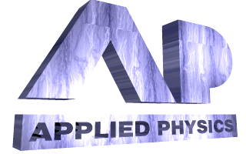
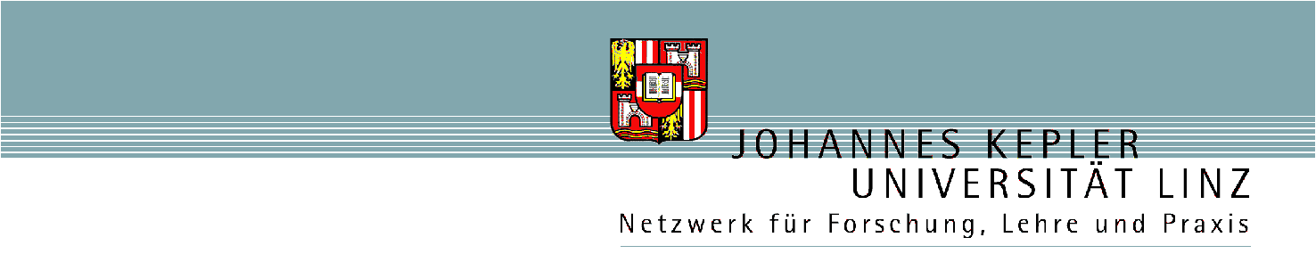
INFLUENCE OF THE SUBSTRATE, METAL OVERLAYER AND LATTICE NEIGHBORS ON THE FOCUSING PROPERTIES OF COLLOIDAL MICROSPHERES
N. Arnold¹
Applied Physics, Johannes Kepler University
A-4040, Linz, Austria
¹Current address: Experimental Physics, J. Kepler University, A-4040, Linz, Austria

Slide 2
History and motivation
Experiments:
  Substrate damage in Laser Cleaning and patterning with ML arrays (Konstanz, Singapore)
  Arrays of microspheres on support used for processing (Linz)
  Metal coated spheres: LIFT, spheres’ arrays with apertures, tailored transmission (Linz)
Theory
  Mie theory – single sphere, complicated (Konstanz, Singapore)
  “Particle on surface” – single sphere + substrate, even more complicated (Singapore, Manchester)
  Dipoles, uniform asymptotics of geometrical optics – single sphere, either small or large (Linz, Konstanz)
  Multi-sphere interference in Gaussian approximation (Linz)
Real life factors: multiple spheres (of intermediate size) + substrate + overlayers + capillary condensation, often simultaneously ⇒ need FDTD and qualitative understanding

Slide 3
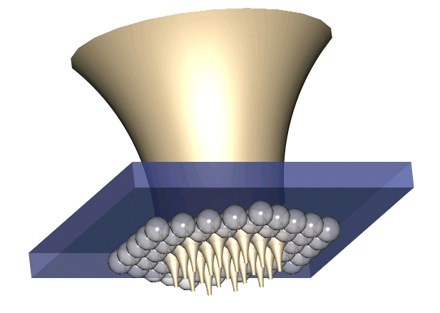
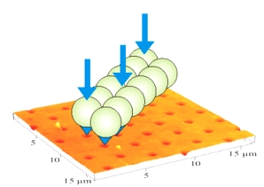
Support, substrate, overlayer
Schematic of the processing with support. Distance can be varied
Patterning of PI by SiO₂ spheres
a=1.5 µm
λ=248 nm
φ = 50 mJ/cm²
100 nm Au film atop of SiO₂ spheres
a=3 µm
λ=248 nm
φ = 40 mJ/cm²
After: J. Klimstein, Diploma Thesis, JKU Linz (2004)
After: K. Piglmayer, R. Denk, D. Bäuerle, Appl. Phys. Lett. 80, 4693 (2002)
L. Landström, J. Klimstein, G. Schrems, K. Piglmayer, D. Bäuerle, Appl. Phys. A. 78, 537 (2004)

Slide 4
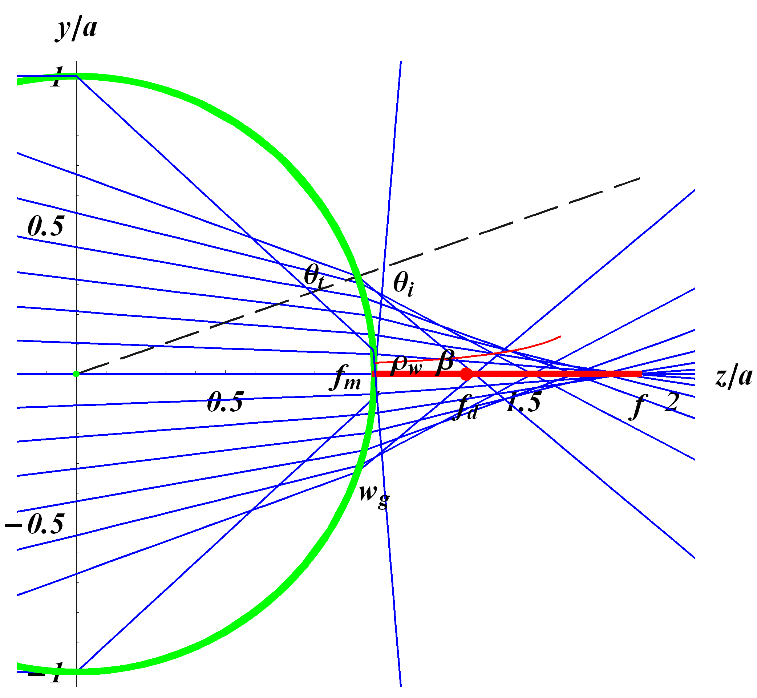
Single large sphere analytics
Main features
Diffraction focus f_{d}
Line caustic, from marginal focus f_{m} to geometrical focus f, width ρ_{w}
Double peak structure ρ_{p}
Geometrical phases and caustic phase shifts
Caustic cuspoid, width w_{g}
θ_{o}

Slide 5
Caustics and focus
Caustic phase shift -π/2 as one of wavefront radii R goes through 0
Caustic cuspoid (meridional R),
on the sphere θ_{o}(θ_{i})→max ⇒
Caustic line (sagittal R) starts outside the sphere:
⇒ e.g., for n=1.35 (SiO₂) intensity under the sphere is much lower than for n=1.6 (PS)
Continues till geometrical focus
Diffraction focus – constructive interference between the axial ray and abaxial ray cone with the shift -π/2-(1/2)π/2 (cuspoid+0.5caustic line) ⇒

Slide 6
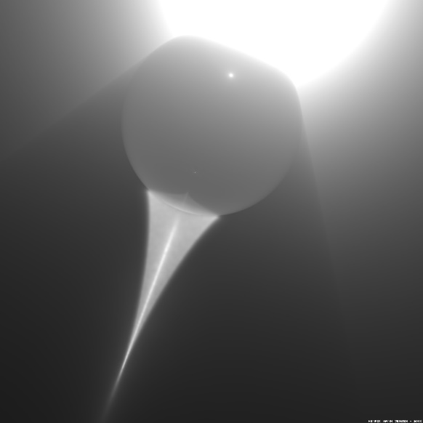
Localization and double peak structure
Caustic line: slowly varying Bessel beam
Width: destructive interference + caustic shift ϕ₁-ϕ₃= π + π /2⇒
smaller than with ideal lens
smallest width is not in the focus, but at large β
Sphere
Just behind the sphere β≈ π /2. On the axis y,z components vanish, near the axis E_{z} is large. Constructive interference: geometry and caustic shift ϕ₁-ϕ₃=π + π /2 ⇒ 2 peaks along polarization direction separated by their FWHM:
Poynting does not have 2 peaks
Notes:
n=1.4, a=3.1 μm, λ=248 nm

Slide 7
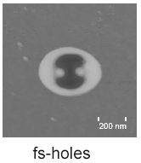
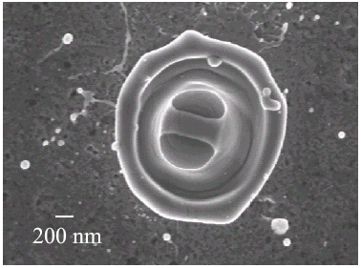
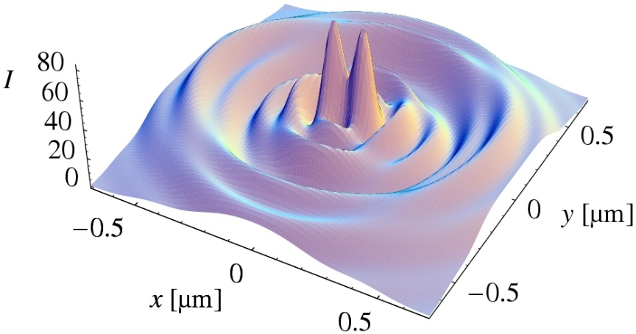
Experimental examples
PS/Si λ=800 nm, 150 fs, sphere radius a=160 nm, small sphere - dipole effect
Münzer H.-J., Mosbacher M., Bertsch M., Dubbers O., Burmeister F., Pack A., Wannemacher R., Runge B.-U., Bäuerle D., Boneberg J., Leiderer P., Proc. SPIE, vol. 4426, 180 (2002)
SiO₂/Ni-foil, λ=248 nm, 500 fs
Large sphere -- radius a=3 µm
D. Bäuerle, G. Wysocki, L. Landström, J. Klimstein, K. Piglmayer, J. Heitz, Proc. SPIE, 5063 8 (2003)
Calculations. Bessoid matching behind the sphere, EE*, λ=248 nm, a=3 µm
After: J. Kofler and N. Arnold, Phys. Rev. B 73 (23), 235401 (2006)

Slide 8
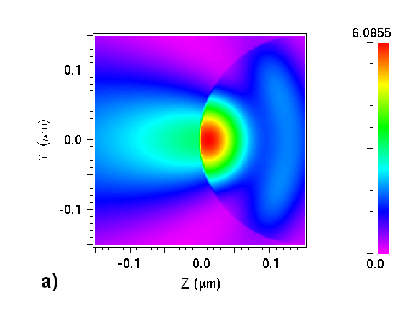
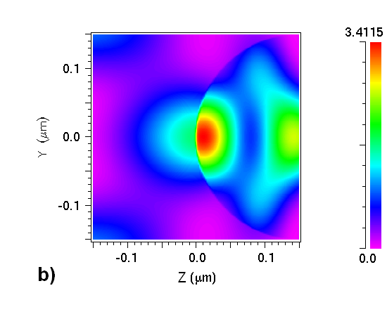
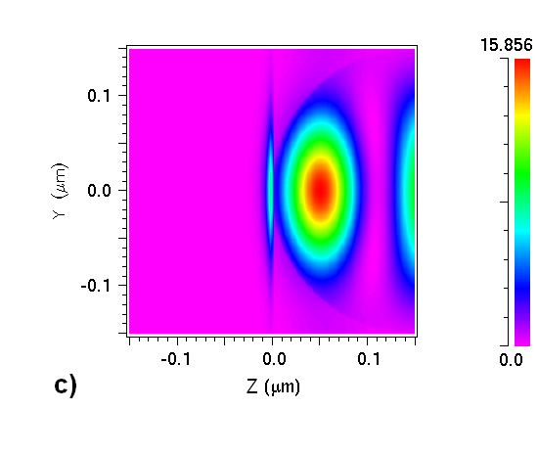
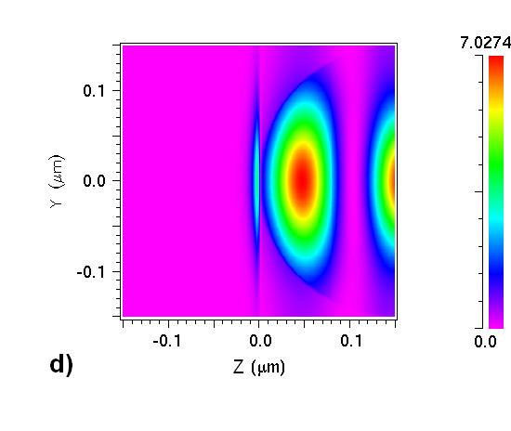
Substrate and nearest neighbors. E-density
Neighbors: E_{den}↓ strongly
Substrate: reflection, field in the sphere ↑ strongly
Field ↑, Flux ↓
like in Fabry-Perot
1 in vacuum
7 in vacuum
1 on Si
7 on Si
Notes:
Influence of the substrate and lattice neighbors. Energy density defined as |Reε|EE*/2 in the yz-plane. Incident x-polarized plane wave has E=1. Figure center is at r=(0,0,a). Laser wavelength λ=266 nm, sphere radius a=150 nm, which corresponds to the Mie parameter ka=3.543. Refractive index of the spheres . . Nearest neighbors in Figs. b) and d) are along x-axis. a) single sphere in vacuum, b) seven spheres in vacuum, c) single sphere on Si, d) seven spheres on Si.

Slide 9
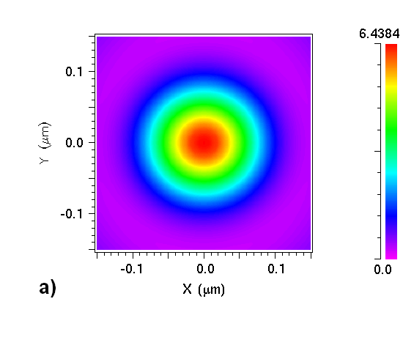
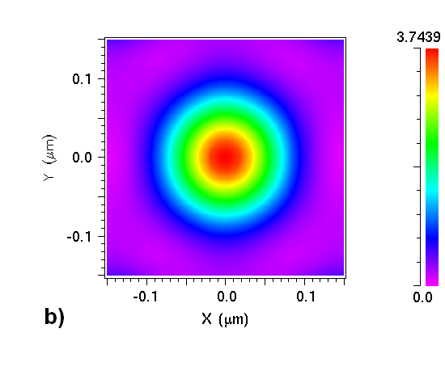
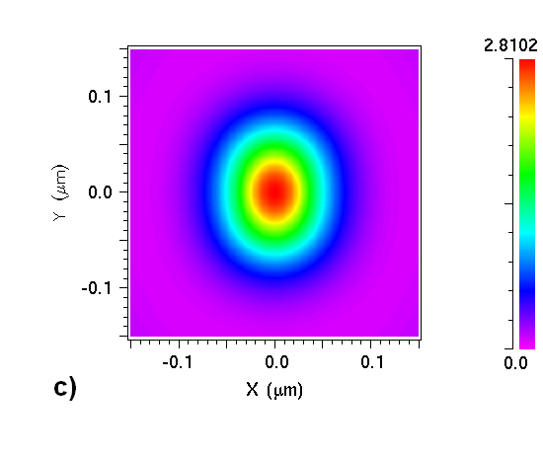
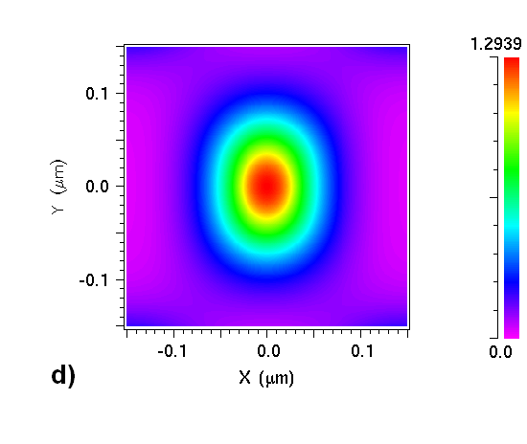
Substrate and nearest neighbors. Poynting
Neighbors: hexagonal symmetry, S_{z} ↓
Substrate: shape elongation ⊥ E, S_{z} ↓
S_{z} more robust than E_{den} because of surfaces, discontinuities, singularities
1 in vacuum
7 in vacuum
1 on Si
7 on Si
Notes:
Distribution of the z-component of Poynting vector, Sz, in the xy-plane. It is normalized to its value in the incident plane wave. Parameters are as in Fig. 2. a) single sphere in vacuum, b) seven spheres in vacuum, c) single sphere on Si, d) seven spheres on Si.

Slide 10
Fabry-Perot estimations
Treat surfaces and wavefronts as ~ plane, neglect the influence of back sphere surface. Consider the gap between the sphere and the substrate as FP resonator with the mirrors R and R_{s}. Just before the gap S_{z}=I₀. Without the substrate “Mie” intensity I_{M}=(1-R)I₀. With the substrate I_{S}≈ transmission of a (thin) FP. Therefore:
sphere
gap
substrate
I₀
I_{S}
R
h
R_{s}
EE* can increase multifold (“high Q”), contains phase-sensitive interference patterns. S_{z} varies much less with changes in parameters and geometry. Comparison:
SiO₂ on Si: R=0.024, R_{s}=0.735. FP: I_{S}/I_{M}≤0.35. FDTD: 0.426 (0.328) for h=30 nm (no singularities).
SiO2 on quartz substrate: R_{s}=R . FP: I_{S}/I_{M}≤1.024. FDTD: 1.097 (1.01)
Reflecting substrate: I_{M}<<I_{S}, “symmetric case” with R_{s}≈R: I_{M} ≥I_{S}

Slide 11
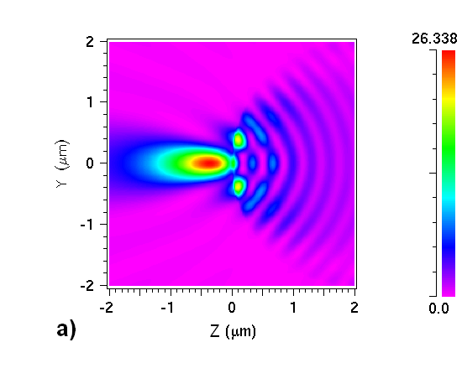
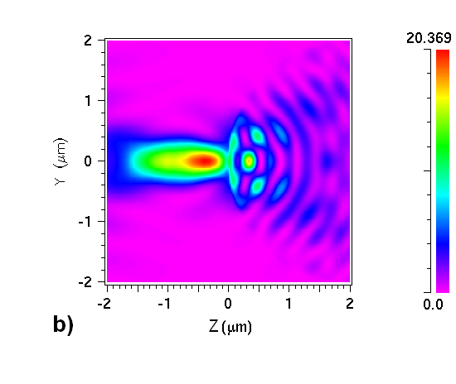
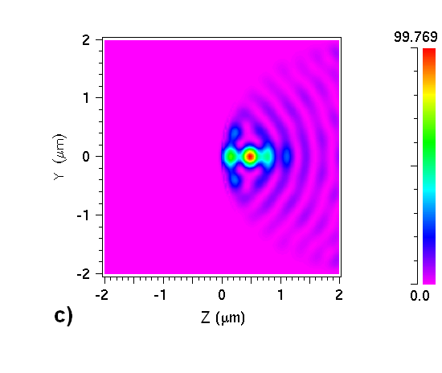
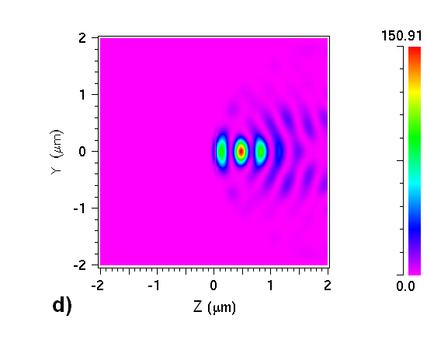
Metal overlayer. E-density
Neighbors: E_{den}↓ noticeably
Substrate: reflection, field in the sphere ↑ strongly
Field ↑, Flux ↓
~ interference of counterpropagating unequal quasi-plane waves
1 in vacuum
7 in vacuum
1 with Au
7 with Au
Notes:
Influence of the metal layer. Energy density |Reε|EE*/2 in the yz-plane. Incident x-polarized plane wave has E=1. Figure center is at r=(0,0,a). Laser wavelength λ=800 nm, sphere radius a=2 μm, which corresponds to the Mie parameter ka=15.708. Refractive index of the spheres . Thickness of the gold layer h=120 nm. . Nearest neighbors in Figs. b) and d) are along x-axis. a) single sphere in vacuum, b) seven spheres in vacuum, c) single metal-covered sphere in vacuum, d) seven metal-covered spheres on quarts support with . Trigonaly-shaped gold islands exist on support between the spheres.

Slide 12
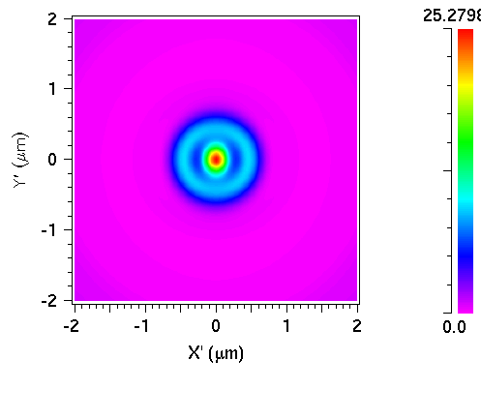
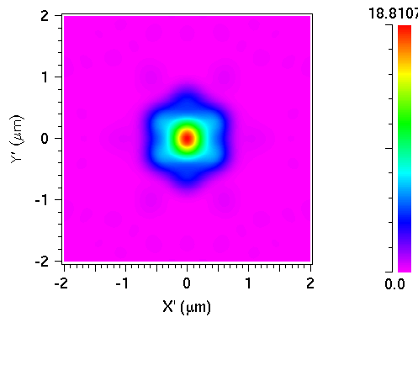
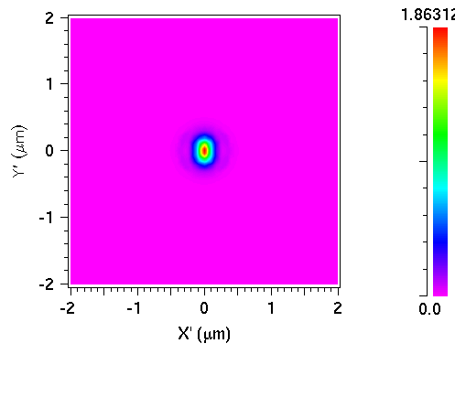

Metal overlayer. Poynting
Neighbors: hexagonal symmetry, S_{z} ↓
Overlayer: shape elongation ⊥ E, S_{z} ↓
Strong decrease in S_{z} values due to reflection (1.86→1.31 with finer mesh)
1 in vacuum
7 in vacuum
1 with Au
7 with Au
Notes:
Distribution of the z-component of Poynting vector, Sz normalized to the value in the incident plane wave in the xy-plane. Figure center is at r=(0,0,a). Laser wavelength λ=800 nm, sphere radius a=2 μm, which corresponds to the Mie parameter ka=15.708. Refractive index of the spheres nSiO2=1.36. Thickness of the gold layer h=120 nm. εAu=nAu2=(0.181+5.125i)2=-26.23+1.855i. Incident light is x-polarized. a) single bare sphere in vacuum, b) seven bare spheres in vacuum, c) single metal-covered sphere in vacuum, d) seven metal-covered spheres in on quarts support with nquartz=1.4

Slide 13
Comments. Reflection, standing waves
Metal reflects light focused by the first refraction with R~1. The reflected rays are further focused and interfere with the incoming light, forming a pattern similar to a standing wave. For two equal counter-propagating plane waves the E_{max} is doubled and EE* quadrupled. This is the case near the metal surface (but not on it!). As incident and reflected waves are unevenly focused, their amplitudes differ, and the maximum EE* is less than quadrupled (107.9 vs. 52.7)
Qualitative features - caustic ring, focal line, (hot spot on the surface) persist. The magnitude of energy flow into the metal, S_{z}, decreases as compared to Mie: I_{m}/I_{M}~1-R~0.0365<<1 as R~const in the broad range of angles.
No surface plasmon effects, as the necessary rays with θ_{t}>θ_{total} required for (local) Kretschmann-like plasmon excitation do not enter the sphere.

Slide 14
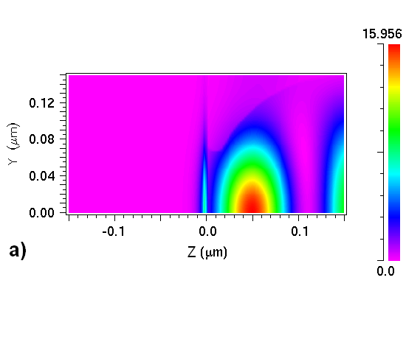
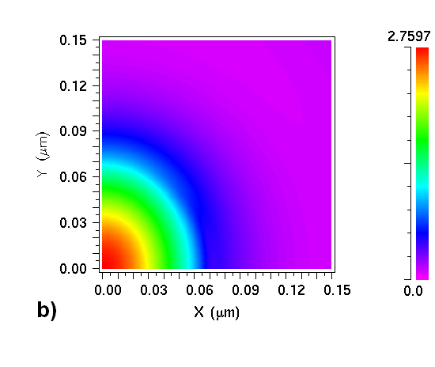
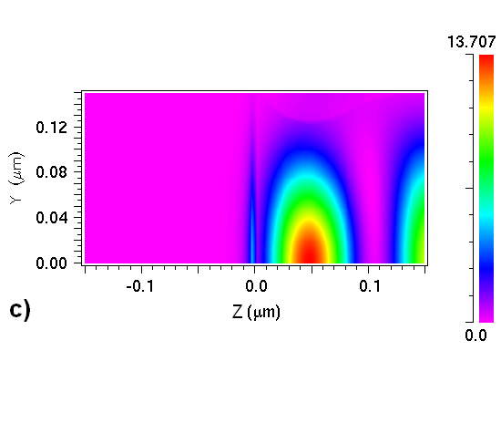
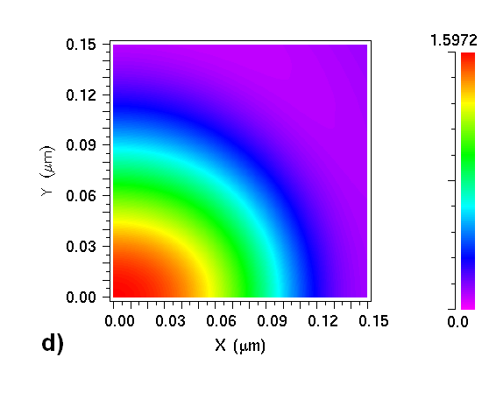
Capillary condensation
RH=0.95, R_{K}=10 nm
SiO₂ on Si, λ=266 nm, etc.
Compare with the results without H₂O
n_{SiO2}≈ n_{H2O}⇒
no second refraction
defocusing, larger area, smaller enhancement, sharply depends on RH
E_{den} S_{z}
Relative humidity RH=0.99
Kelvin radius R_{K}≈ 0.52/ln(RH⁻¹)=50 nm
Notes:
Influence of capillary condensation. Figure origin (0,0,0) is at r=(0,0,a). Single SiO2 sphere on Si. a), b) Kelvin radius RK=10 nm (RH=0.95). c), d) RK=50 nm (RH=0.99). a), c) Energy density |Reε|EE*/2 in yz-plane. b), d) z-component of Poynting vector, Sz in xy-plane. Refractive index of the water meniscus . Other laser and material parameters are as in Figs 2,3.

Slide 15
FDTD parameters
E_{den} is plotted as |ε’|EE*/2
Incident x-polarized plane wave with E=1
Adjacent spheres are along x-axis
Small SiO₂ spheres on Si, a=150 nm, λ=266 nm (ka=3.54)
As in: D. Brodoceanu, L. Landström, D. Bäuerle, Appl. Phys. A., 86(3), 313 (2007)
Large SiO₂ spheres with Au, a=2 μm, λ=800 nm (ka=15.7)
Gold layer h=120 nm
As in: G. Langer, D. Brodoceanu, and D. Bäuerle, Appl. Phys. Lett. 89 (26), 261104, (2006)

Slide 16
Conclusions
Focusing by large spheres -- uniform asymptotics of geometrical optics, caustic phase shifts. Line caustic, lateral localization better than for the ideal lens, double peak structure near the sphere due to E_{z}.
Substrate strongly modifies the intensity under the sphere. This can be understood using Fabry-Perot model. Energy flowing into a reflecting substrate is significantly lower than expected from Mie.
Metallic overlayer acts as a reflecting mirror. It increases the peak intensity inside the sphere, but decreases the flow of energy into the metal as compared to Mie. This may lead to sphere damage and is important for the analysis of LIFT process and aperture formation.
Nearest lattice neighbors modify the field distribution in the planes parallel to the ML and noticeably change the intensity in the focal area.
Capillary condensation decreases the peak enhancement, delocalizes high-field region.
Field enhancement estimations based on Mie or even more advanced semi-analytical models can be way off and should be applied cautiously to a quantitative analysis of real experiments.

Slide 17
Acknowledgements
Discussions:
Prof. B. Luk’yanchuk (Singapore)
Dr. Z. Wang (Manchester)
Dr. L. Landström (Uppsala)
DI. J. Kofler (Vienna)
Prof. D. Bäuerle (Linz)
FDTD help:
CD Laboratory for Surface Optics (Linz)
Univ. Doz. Dr. K. Hingerl
MSc. V. Lavchiev

Slide 18
Literature
1. H. J. Münzer, M. Mosbacher, M. Bertsch, O. Dubbers, F. Burmeister, A. Pack, R. Wannemacher, B. U. Runge, D. Bäuerle, J. Boneberg, and P. Leiderer, Proc. SPIE 4426, 180 (2002).
2. S. M. Huang, M. H. Hong, B. S. Luk'yanchuk, Y. W. Zheng, W. D. Song, Y. F. Lu, and T. C. Chong, J. Appl. Phys. 92 (5), 2495 (2002).
3. D. Brodoceanu, L. Landström, and D. Bäuerle, Appl. Phys. A 86 (3), 313 (2007).
4. R. Denk, K. Piglmayer, and D. Bäuerle, Appl. Phys. A A74 (6), 825 (2002).
5. D. Bäuerle, K. Piglmayer, R. Denk, and N. Arnold, Lambda Highlights 60, 1 (2002).
6. L. Landström, N. Arnold, D. Brodoceanu, K. Piglmayer, and D. Bäuerle, Appl. Phys. A A83 (2), 271 (2006).
7. L. Landström, J. Klimstein, G. Schrems, K. Piglmayer, and D. Bäuerle, Appl. Phys. A A78 (4), 537 (2004).
8. G. Langer, D. Brodoceanu, and D. Bäuerle, Appl. Phys. Lett. 89 (26), 261104 (2006).
9. B. S. Luk'yanchuk, M. Mosbacher, Y. W. Zheng, H. J. Münzer, S. M. Huang, M. Bertsch, W. D. Song, Z. B. Wang, Y. F. Lu, O. Dubbers, J. Boneberg, P. Leiderer, M. H. Hong, and T. C. Chong, in Laser cleaning (World Scientific, 2002), 103.
10. B. S. Luk'yanchuk, Y. W. Zheng, and Y. F. Lu, Proc. SPIE 4065, 576 (2000).
11. N. Arnold, Appl. Surf. Sci. 208-209, 15 (2003).
12. J. Kofler and N. Arnold, Phys. Rev. B 73 (23), 235401 (2006).
13. L. Landström, D. Brodoceanu, K. Piglmayer, and D. Bäuerle, Appl. Phys. A., 84 (4), 373 (2006).
14. R. Denk, K. Piglmayer, and D. Bäuerle, Appl. Phys. A A76 (1), 1 (2003).
15. N. Arnold, G. Schrems, and D. Bäuerle, Appl. Phys. A A79, 729 (2004).
16. Y. A. Kravtsov and Y. I. Orlov, Geometrical optics of inhomogeneous media. (Springer-Verlag, Berlin ; New York, 1990).
17. M. Born and E. Wolf, Principles of optics : electromagnetic theory of propagation, interference and diffraction of light, 7th expanded ed. (Cambridge University Press, Cambridge ; New York, 1999).
18. H. J. Münzer, M. Mosbacher, M. Bertsch, J. Zimmermann, P. Leiderer, and J. Boneberg, J. Microsc. 202 (1), 129 (2001).
19. D. Bäuerle, G. Wysocki, L. Landström, J. Klimstein, K. Piglmayer, and J. Heitz, Proc. SPIE 5063 8(2003).
20. J. Kofler, J. Kepler University, 2004.
21. D. Bedeaux and J. Vlieger, Optical properties of surfaces. (Imperial College Press, London, 2002).
22. L. Landström, D. Brodoceanu, K. Piglmayer, and D. Bäuerle, Appl. Phys. A., 81 (1), 15 (2005).
23. L. Landström, D. Brodoceanu, N. Arnold, K. Piglmayer, and D. Bäuerle, Appl. Phys. A A81 (5), 911 (2005).
24. A. Pikulin, N. Bityurin, G. Langer, D. Brodoceanu, and D. Bäuerle, Appl. Phys. Lett.?? (?), ??? (2007).

