Slide 1
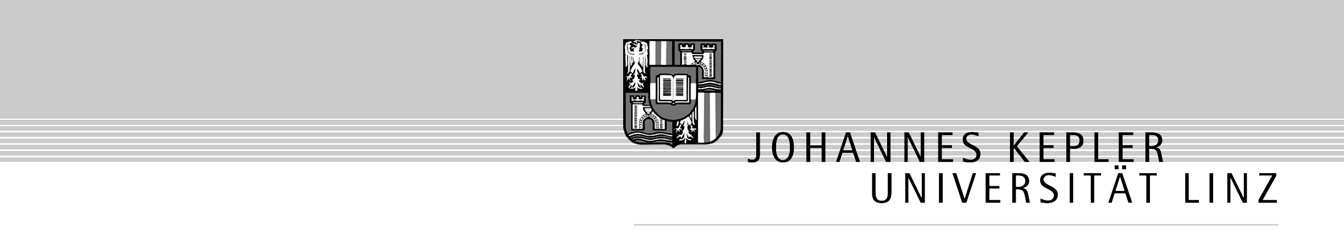
Dry Laser Cleaning and
Focusing of Light in Axially Symmetric Systems
Johannes Kofler and Nikita Arnold
Institute for Applied Physics
Johannes Kepler University Linz
4th International Workshop on Laser Cleaning
Macquarie University, Sydney, Australia
December 15th, 2004

Slide 2
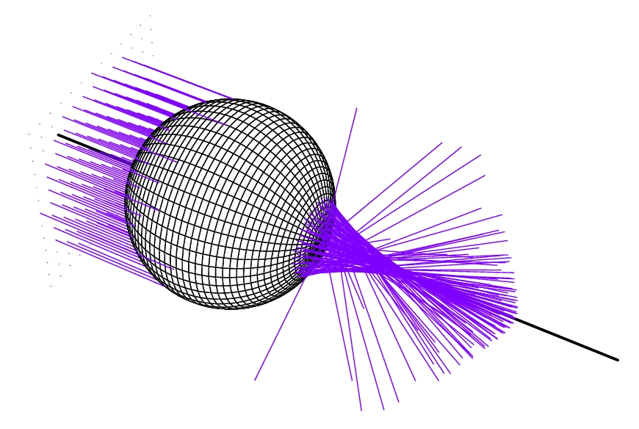
1. Motivation
Local field enhancement underneath particulates
  plays an important role in cleaning of surfaces
  and in recent experiments on submicron- and nano-patterning
Goal: Intensity distribution behind a sphere
  as analytical as possible
  fast to compute
  improve physical understanding
Wave field behind a focusing system is hard to calculate
  geometrical optics intensity goes to infinity in the focal regions
  diffraction wave integrals are finite but hard to calculate (integrands are highly oscillatory)
  available standard optics solutions (ideal lens, weak aberration) are inapplicable
  theory of Mie: complicated and un-instructive (only spheres)
Approach
  matching the solution of geometrical optics (in its valid regions) with a canonical wave field
  disadvantage: geometrical optics must be valid (only for large Mie parameters)
  advantage: compact and intuitive results (for arbitrary axially symmetric systems)

Slide 3
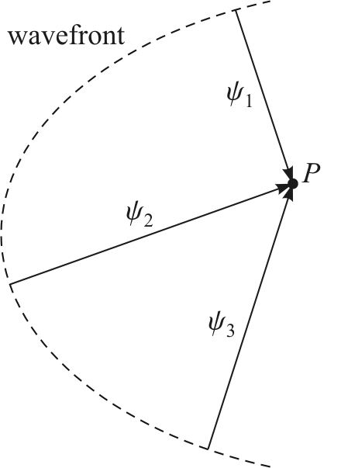
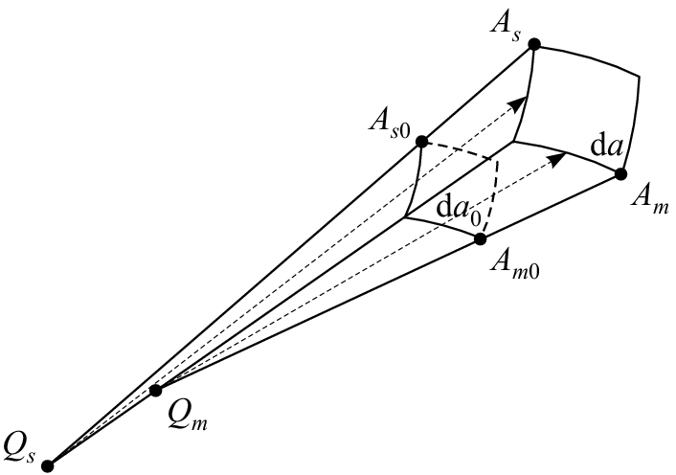
2. Geometrical Optics
Rays (wavefront normals) carry the information of amplitude and phase
A ray is given by
U₀ initial amplitude
ψ eikonal (optical path)
J divergence of the ray
Flux conservation:
Field diverges (U → ∞) if R_{m} → 0 or R_{s} → 0
R_{m} ≡ Q_{m}A_{m}
R_{s} ≡ Q_{s}A_{s}

Slide 4
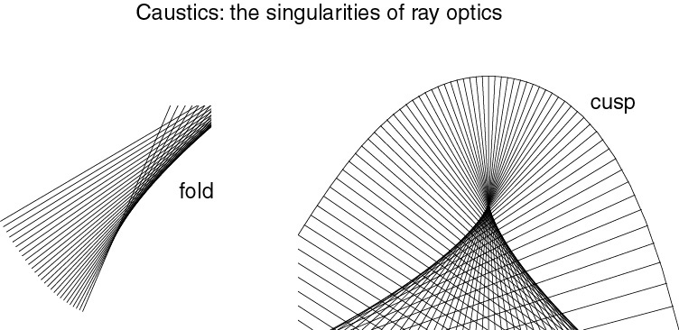
Caustics (Greek: “burning”)
Caustics are regions where the field of geometrical optics diverges (i.e. where at least one radius of curvature is zero).
Caustic phase shift
Passing a caustic: R_{m} or R_{s} goes through zero and changes its sign (from converging to diverging)
caustic phase shift (delay) of Δϕ = – π / 2

Slide 5
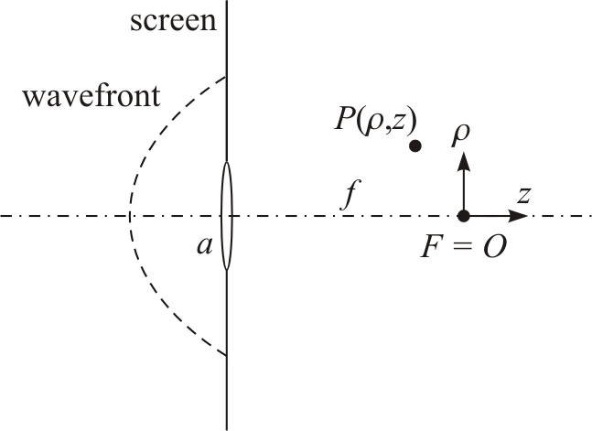
3. Diffraction Integrals
Wave field in a point P behind a screen A:
summing up contributions from all virtual point sources on the screen
For a spherically aberrated wave with small angles everywhere we get
U(ρ,z) ∝ I(R,Z)
where R ∝ ρ, Z ∝ z
The integral I(R,Z) is denoted as Bessoid integral

Slide 6
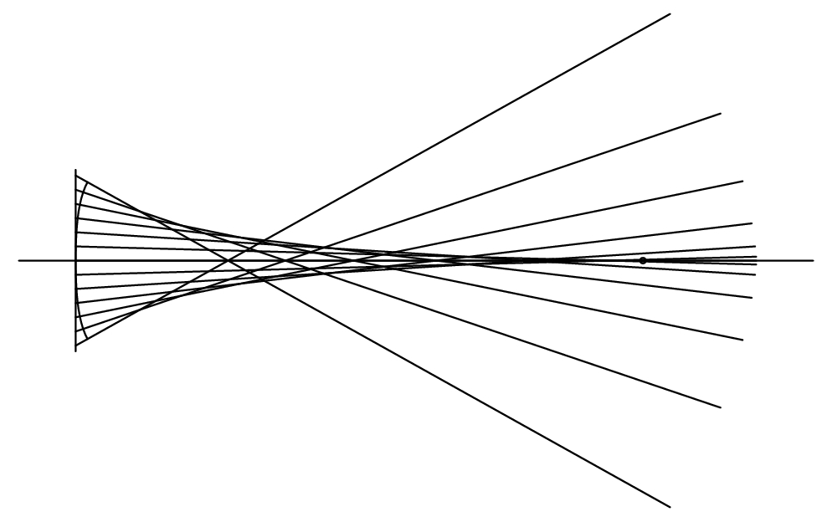
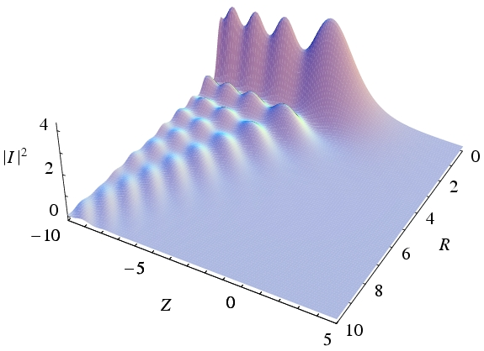
The Bessoid integral
Bessoid Integral I
3-d: R,ϕ,Z
Cuspoid catastrophe + ‘hot line’

Slide 7
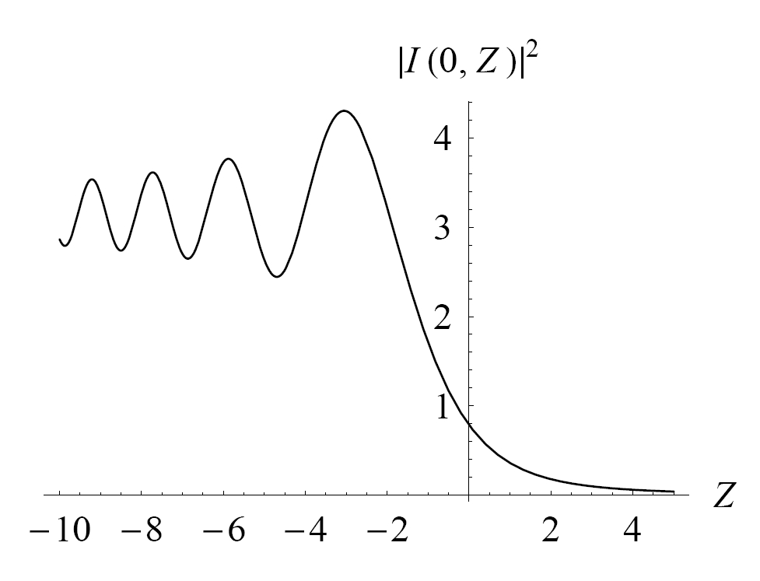
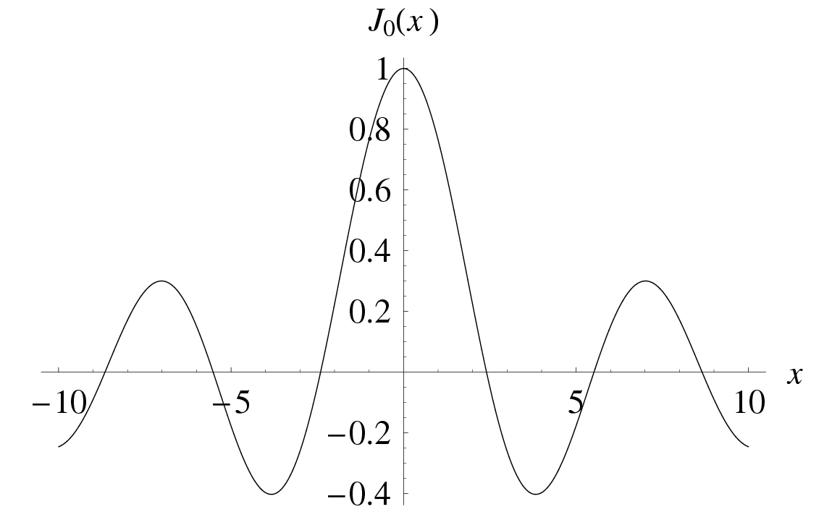
Analytical expressions for the Bessoid integral
On the axis
(Fresnel sine and cosine functions):
Near the axis (Bessel beam)

Slide 8
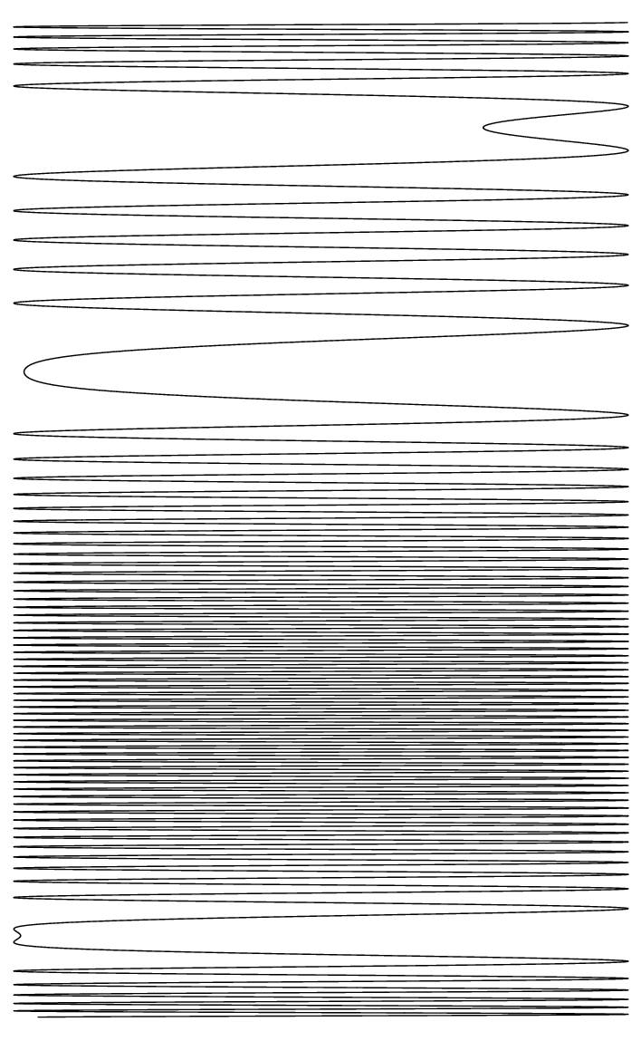
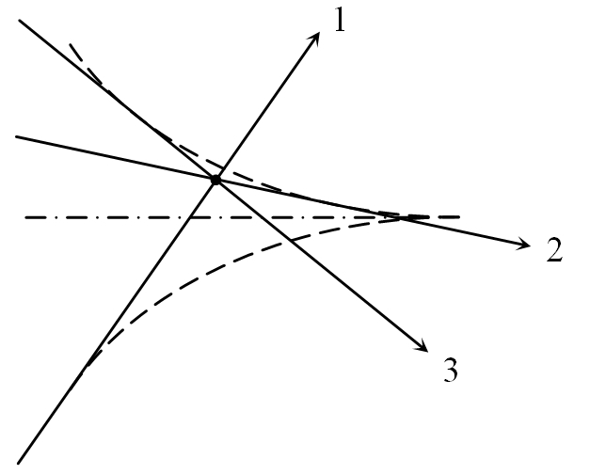
Stationary phase and geometrical optics rays

Slide 9
4. Wave Picture: Matching Geometrical Optics and Bessoid Integral
Summary and Outlook:
Wave optics are hard to calculate
Geometrical optics solution can be “easily” calculated in many cases
Paraxial case of a spherically aberrated wave → Bessoid integral I(R,Z)
I(R,Z) has the correct cuspoid topology of any axially symmetric 3-ray problem
Describe arbitrary non-paraxial focusing by matching the geometrical solution with the Bessoid (and its derivatives) where geometrical optics works
(uniform caustic asymptotics, Kravtsov-Orlov: “Caustics, Catastrophes and Wave Fields”)

Slide 10
6 knowns: ψ₁, ψ₂, ψ₃, J₁, J₂, J₃ 6 unknowns: R, Z, χ, A, A_{R}, A_{Z}
And this yields
R = R(ψ_{j}) = R(ρ, z)
Z = Z(ψ_{j}) = Z(ρ, z)
χ = χ(ψ_{j}) = χ(ρ, z)
A = A(ψ_{j}, J_{j}) = A(ρ, z)
A_{R} = A_{R}(ψ_{j}, J_{j}) = A_{R}(ρ, z)
A_{Z} = A_{Z}(ψ_{j}, J_{j}) = A_{Z}(ρ, z)
Coordinate transformation
Amplitude matching
Matching removes divergences of geometrical optics
Rather simple expressions on the axis

Slide 11
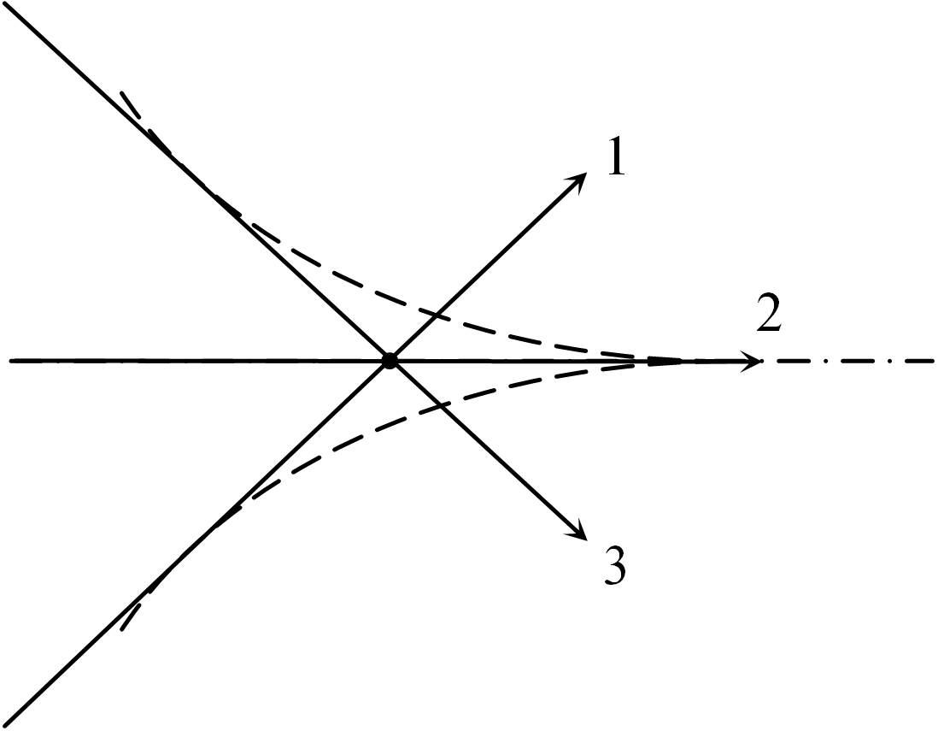
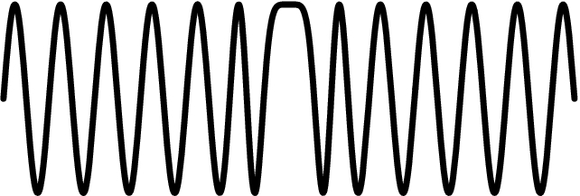
On the axis:
First maximum: ray 1 and 2 must be in phase
Naive answer: ϕ₁ – ϕ₂ = 0 or 2 π (wrong)
Phase shift of ray 1: Δϕ₁ = – π / 2 – π / 4 = – 3 π / 4
ϕ₁ – ϕ₂ = 3 π / 4 = 2.356 (geometrical)
Bessoid: ϕ₁ – ϕ₂ = 2.327 (wave correction)

Slide 12
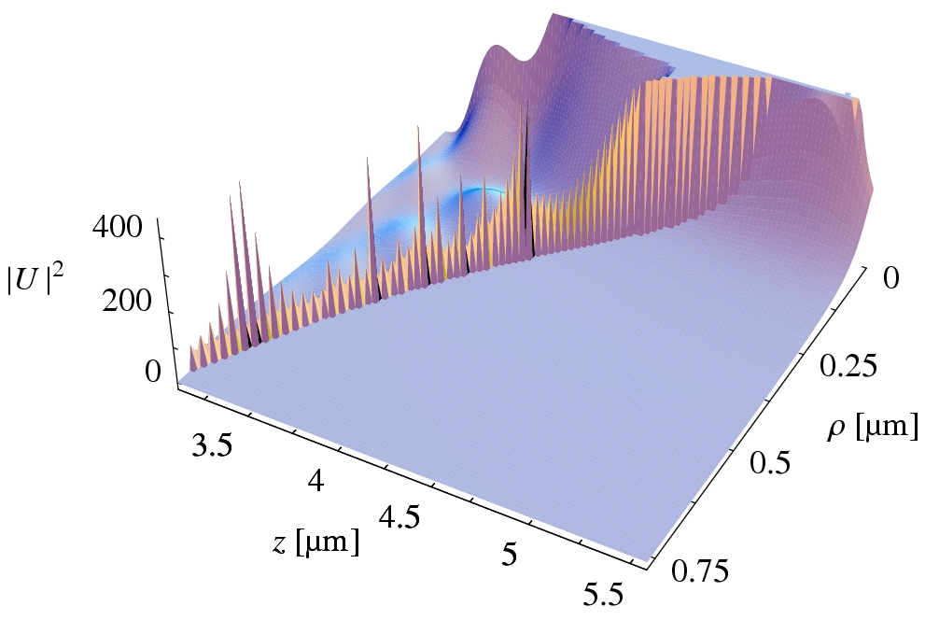
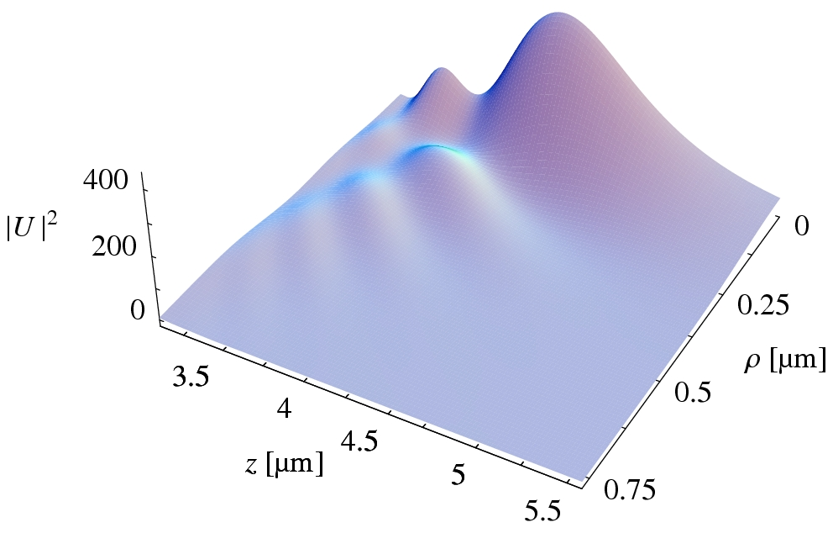
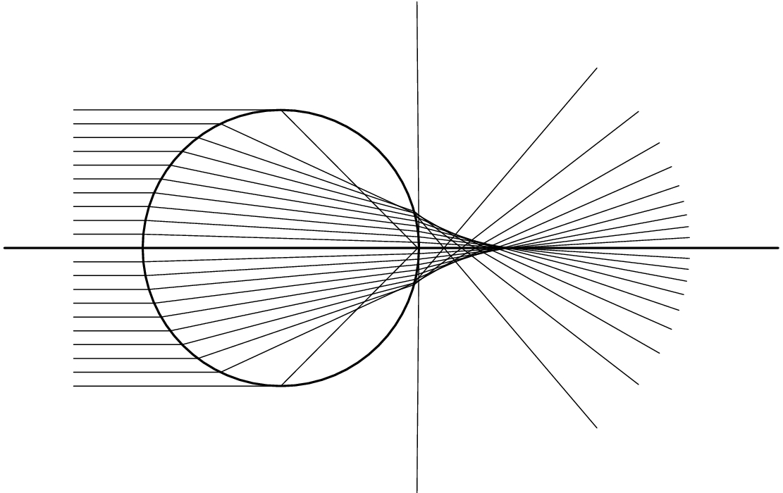
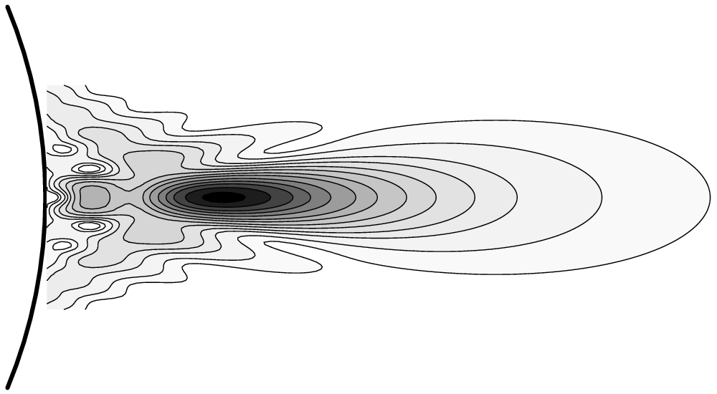
5. The Sphere
Sphere radius: a = 3.1 µm Refractive index: n = 1.42 Wavelength: λ = 0.248 µm
Geometrical optics solution:
Bessoid matching:

Slide 13
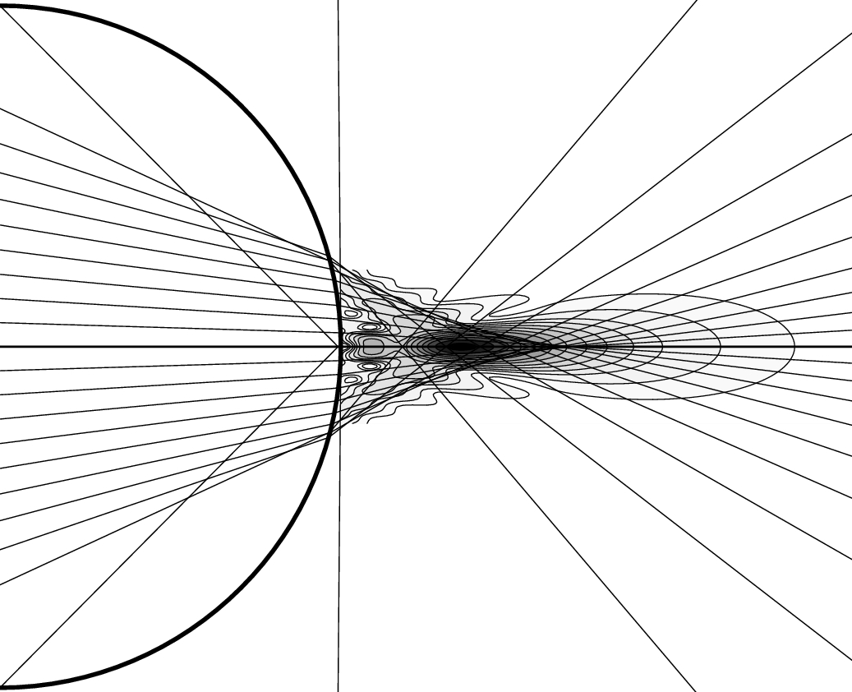
λ
a
large depth of a narrow ‘focus’
(good for processing)

Slide 14
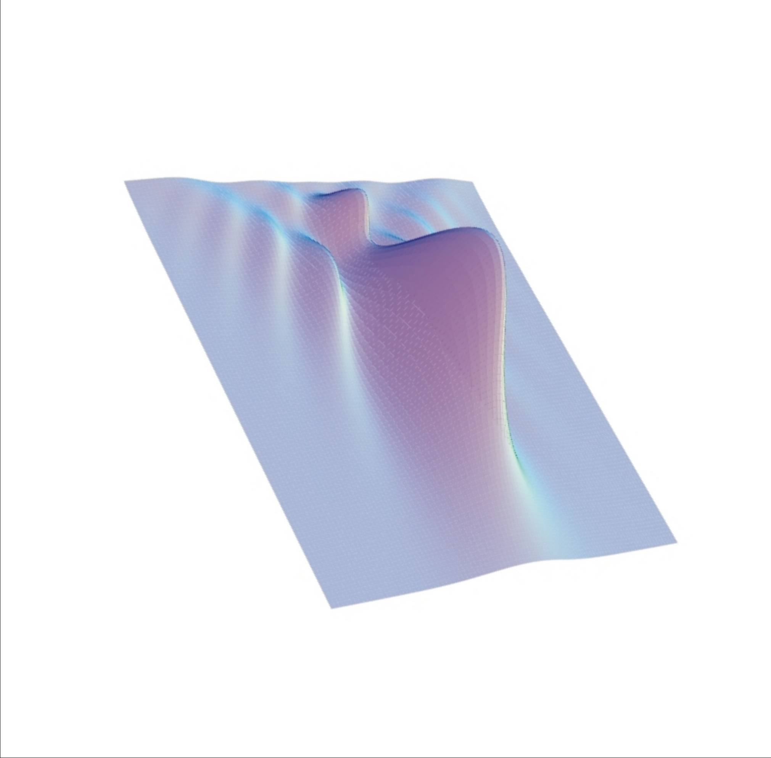
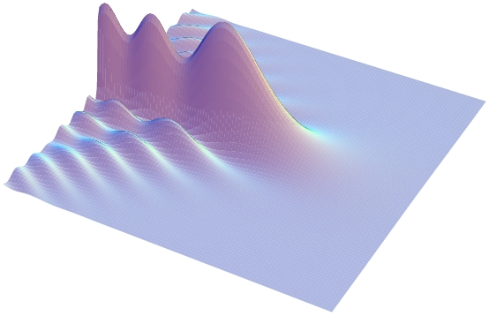
Illustration
Bessoid-matched solution
Bessoid integral
Geometrical optics solution

Slide 15
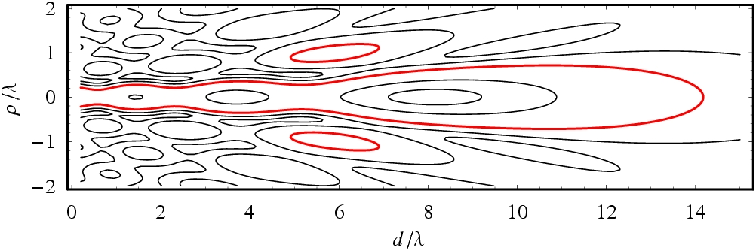
Properties of Bessoid important for applications:
near the axis: Bessel beam with slowly varying cross section
smallest width is not in the focus
width from axis to first zero of Bessel function:
(width is smaller than with any lens)
diverges slowly: large depth of focus (good for processing)
β

Slide 16
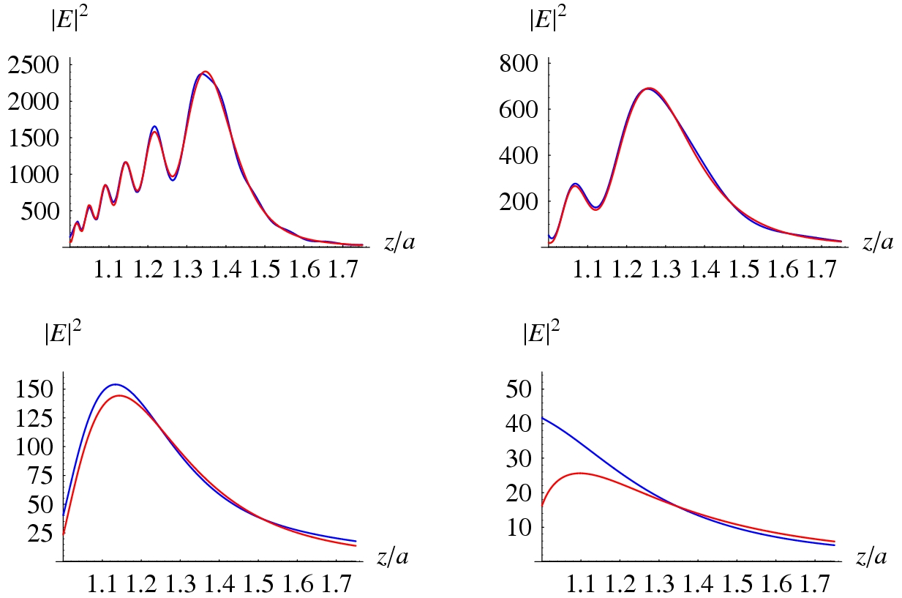
Bessoid matching
Mie theory
Refractive index: n = 1.5
intensity |E|² ∝ k a ∝ a / λ
q ≡ k a = 300
a_{0.248 µm} ≈ 12 µm
q ≡ k a = 100
a_{0.248 µm} ≈ 4 µm
q ≡ k a = 30
a_{0.248 µm} ≈ 1.2 µm
q ≡ k a = 10
a_{0.248 µm} ≈ 0.4 µm

Slide 17
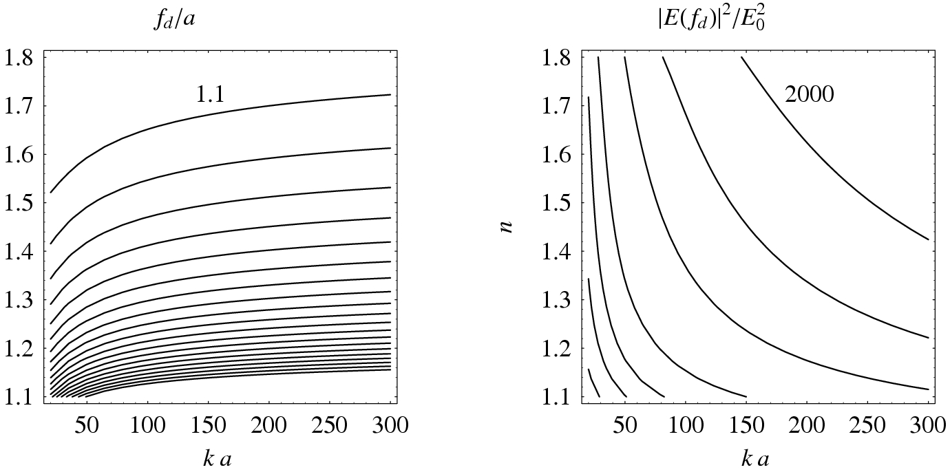
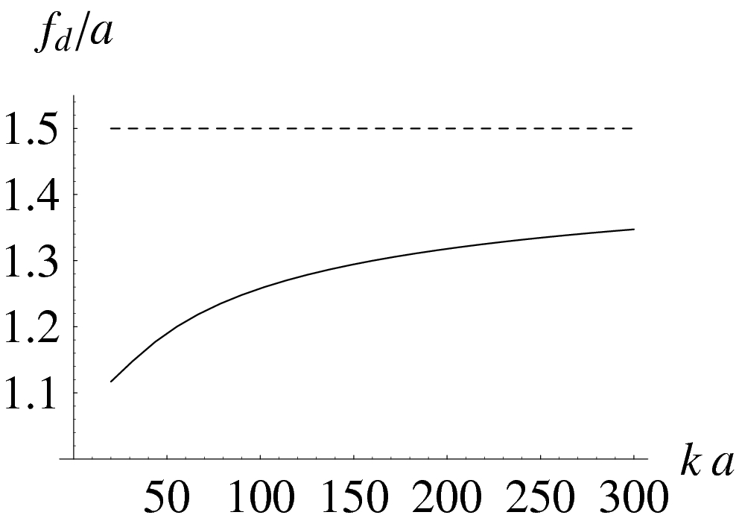
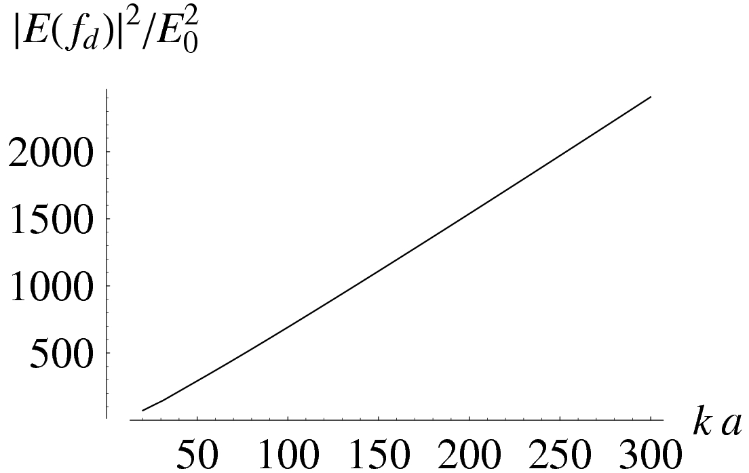
Diffraction focus f_{d} and maximum intensity |E(f_{d})|²
1.2
1.3
n
1000
500
200
3.0
100
n = 1.5
n = 1.5
f / a
∝ k a

Slide 18
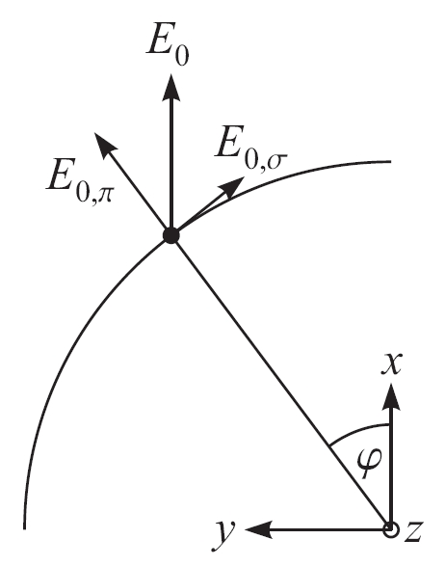
6. Generalization to Vector Fields
What happens if the incident light is linearly polarized?
Modulation of initial vectorial amplitude on spherically aberrated wavefront → axial symmetry broken
Use higher-order Bessoid integrals:
I₀ ≡ I
Geometrical optics terms with ϕ-dependence cos(mϕ) or sin(mϕ)
have to be matched with m-th order Bessoid integral I_{m}
Coordinate equations (R, Z, χ) remain the same (cuspoid catastrophe)
Amplitude equations (A_{m}, A_{Rm}, A_{Zm}) are modified systematically

Slide 19
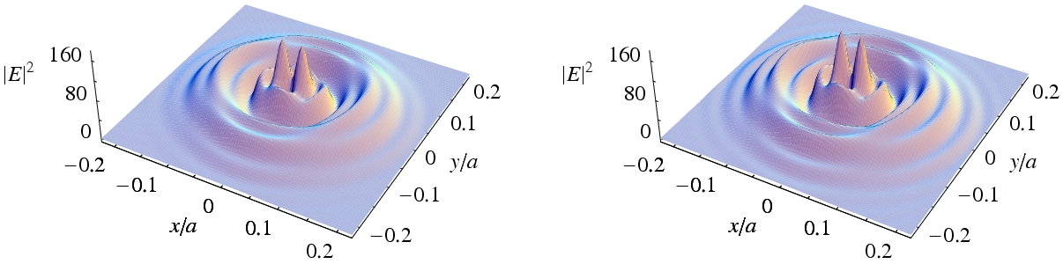
Electric field immediately behind the sphere (z ≈ a)
in the x,y-plane
(k a = 100, incident light x-polarized, normalized coordinates)
Bessoid matching Theory of Mie
Double-hole structures have been observed in various different systems, e.g.,
PS/Si (100 fs), Münzer et al. 2002
SiO₂/Ni-foil (500 fs), Landström et al. 2003

Slide 20
Conclusions
Axially symmetric focusing → Bessoid integral with cuspoid and focal line caustic
Matching of geometrical optics (caustic phase shifts) with Bessoid wave field removes divergences
Universal expressions (i) for the on-axis vector field and (ii) for the diffraction focus
On axis: high intensity (∝ k a) everywhere
Near the axis: Bessel beam, optimum resolution near the sphere
Vectorial non axially symmetric amplitudes need higher-order Bessoid integrals
Double-peak structure near the sphere surface reproduced and explained (unrelated to near field effects)
Good agreement with Mie theory down to k a ≈ 20 (a / λ ≈ 3)
Cuspoid focusing is important in many fields of physics:
    propagation of acoustic, electromagnetic and water waves
    semiclassical quantum mechanics
    scattering theory of atoms
    chemical reactions

Slide 21
Acknowledgements
Prof. Dieter Bäuerle
Dr. Klaus Piglmayer, Dr. Lars Landström, DI Richard Denk, Johannes Klimstein and Gregor Langer
Prof. B. Luk’yanchuk, Dr. Z. B. Wang (DSI Singapore)

Slide 22
Appendix

Slide 23
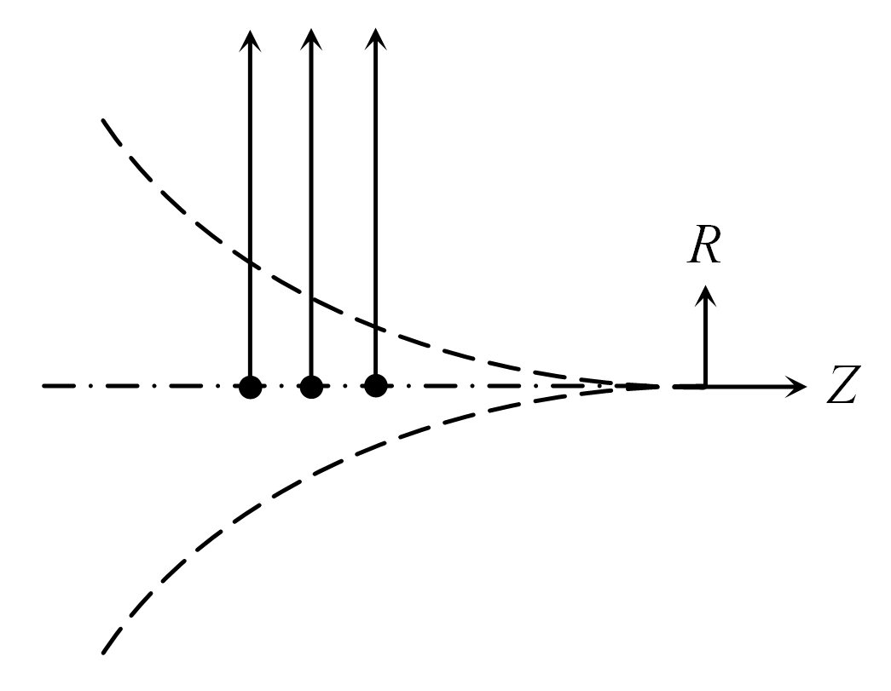
Numerical Computation of the Bessoid integral
Direct numerical integration along the real axis
  Integrand is highly oscillatory, integration is slow and has to be aborted
  T_{100x100} > 1 hour
Numerical integration along a line in the complex plane (Cauchy theorem)
    Integration converges
    T_{100x100} ≈ 20 minutes
Solving numerically the corresponding differential equation for the Bessoid integral I (T_{100×100} ≈ 2 seconds !)
paraxial Helmholtz equation in polar coordinates + some tricks →
one ordinary differential equation in R for I (Z as parameter)

