Slide 1


TRANSMISSION THROUGH COLLOIDAL MONOLAYERS WITH AN OVERLAYER – A THEORETICAL CONSIDERATION
N. Arnold
Angewandte Physik, Johannes - Kepler - Universität
A-4040, Linz, Austria

Slide 2
Summary
History and motivation
Transmission of bare colloidal monolayers
  Rayleigh-Wood anomalies in diffraction
a-Si covered monolayers
  Photonic crystals
  Mode profiles and coupling
Metal covered monolayers
  Minimal model of plasmon-mediated transmission

Slide 3
History and motivation
Patterning in Laser Cleaning and with ML arrays (Konstanz, Singapore)
Arrays of microspheres on support used for processing (Linz)  need to understand the bare ML transmission properties
a-Si covered spheres for light manipulation  need to understand the transmission properties with the Si overlayer
Metal coated spheres for LIFT and apertured spheres arrays  need to understand plasmonic effects

Slide 4
Transmission measurements
Spectrometer
Far field, direct transmission (normal or oblique)
Not a laser light
Non-polarized
Monolayer domains in irradiated area

Slide 5
Bare SiO₂ monolayer
Decrease at small λ:
Diffraction grating, interference from a “primitive cell”:
Dip: wavelength scales with d: d/λ~1.12
No order - no dip

Slide 6
Rayleigh-Wood anomaly
Known in gratings of all types. Diffracted waves at the grazing angle  couple  consume energy
Energy conservation  dip in zero order (normal transmission)
Large-angles  requires full 3D vector Maxwell equations.
k
k
b
k’=k+b
θ
k

Slide 7
Dip condition
Bragg condition:
b - reciprocal lattice (2D hexagonal)
Normal incidence, 1st order diffraction, possibility to couple
b₂
b₁
M
K
a₂
Effective n_{mon} from the filling factor f ≈ 0.6
and mixing law for ε :
Γ
a₁
Notes:
f=Pi/3 sqrt(3)

Slide 8
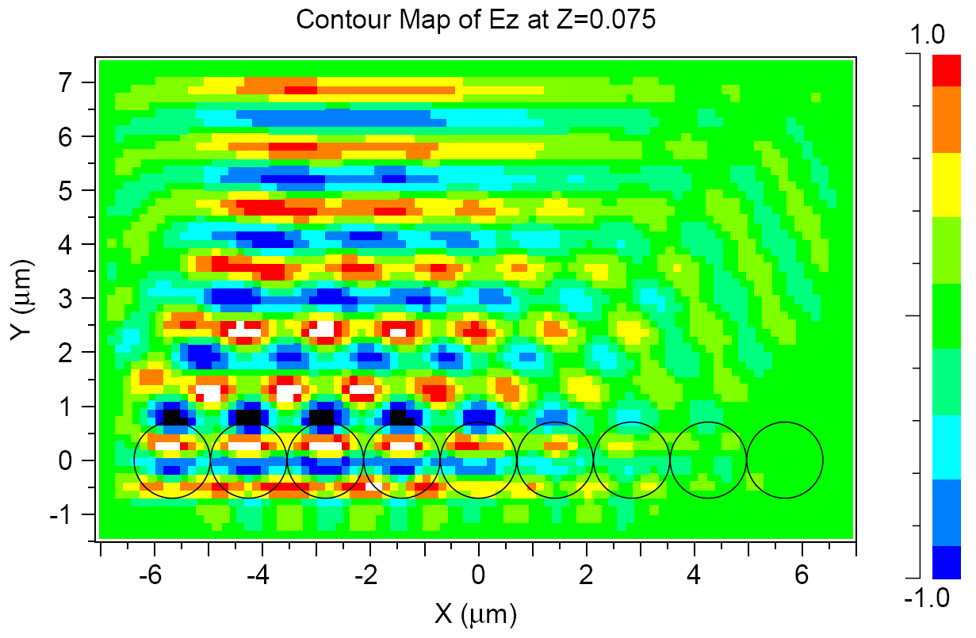
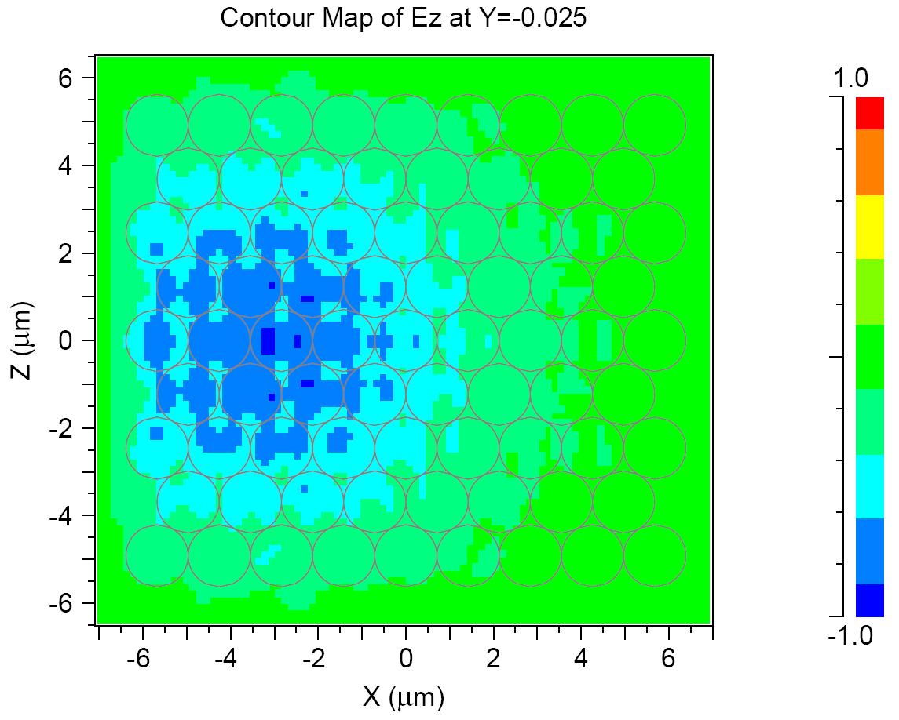
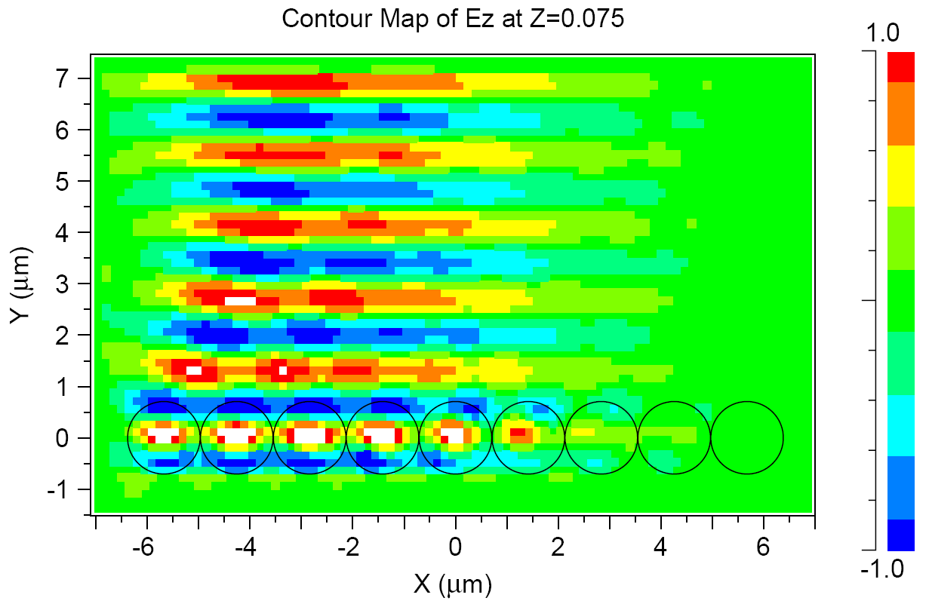
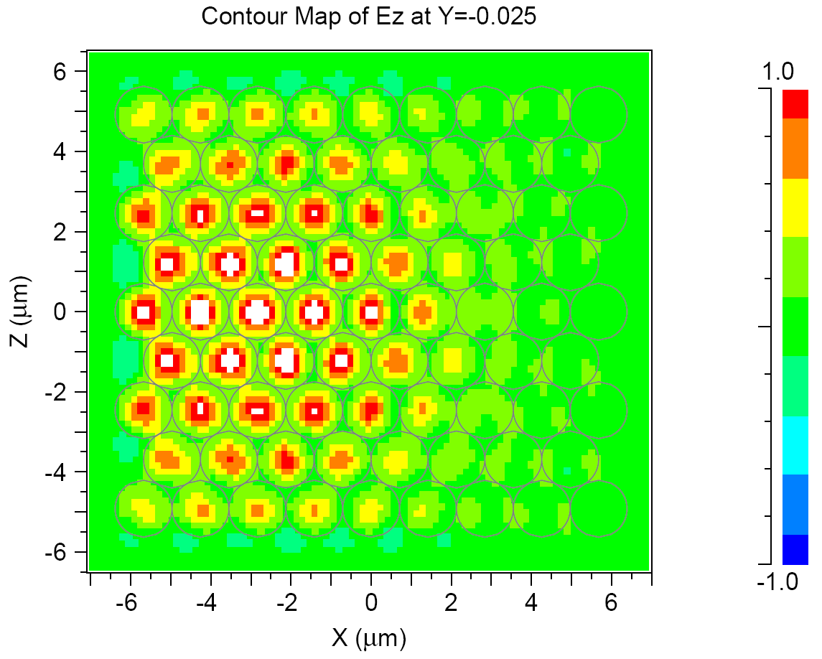
FDTD calculations
λ/d=0.8
λ/d=1.0
Notes:
Full vector FDTD calculations of the light coupling into the monolayer of dielectric spheres with n=1.42, d=1.42 µm. Normally incident excitation field is polarized in z-direction and has a Gaussian profile with the (1/e field) width w0=5 µm centered at x=-3 µm

Slide 9
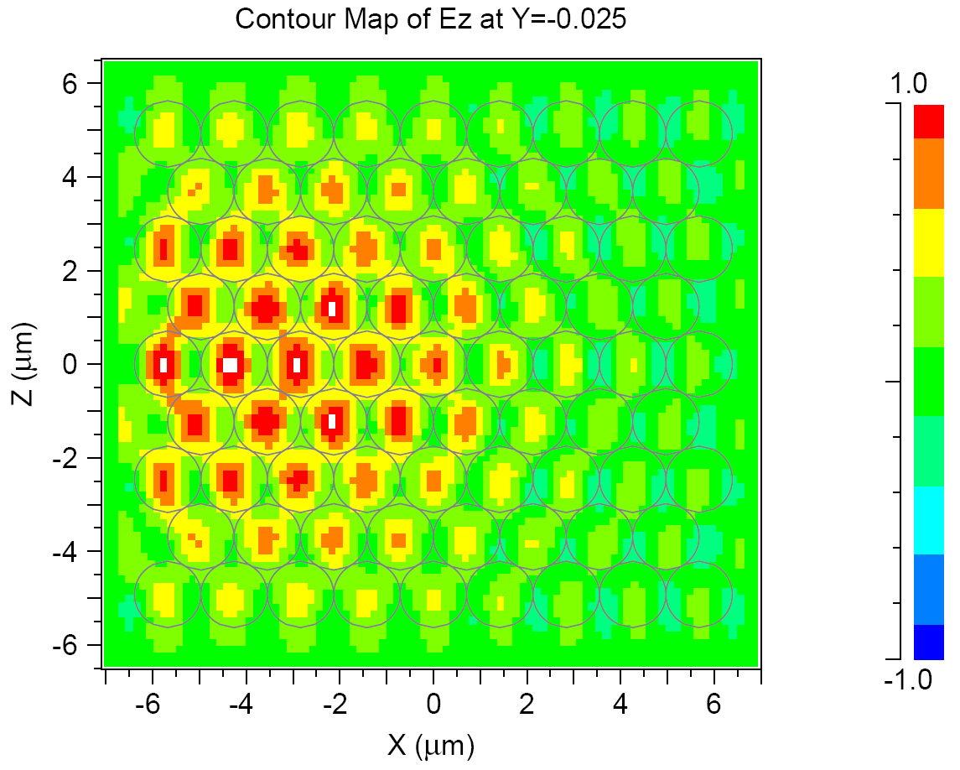
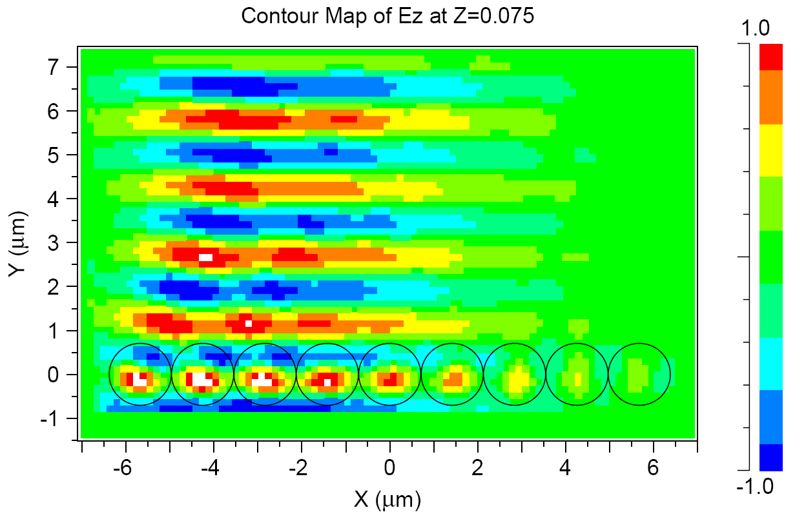
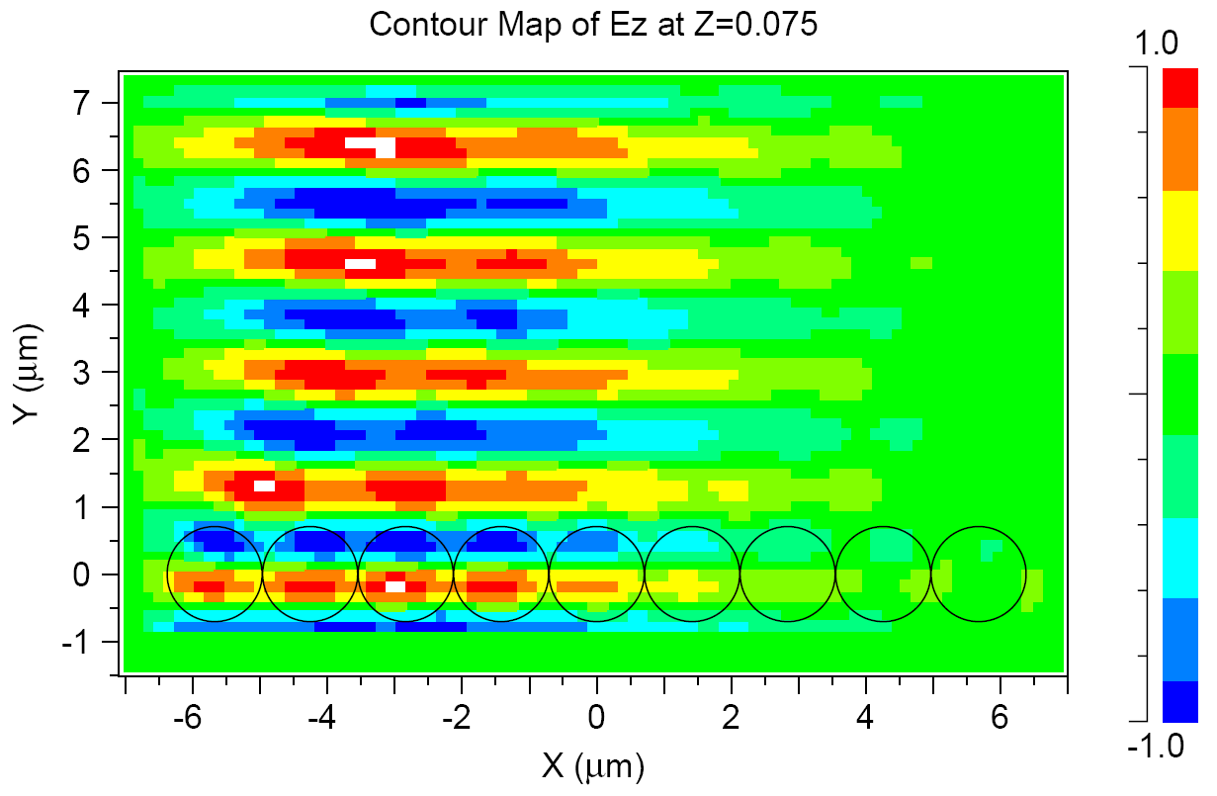
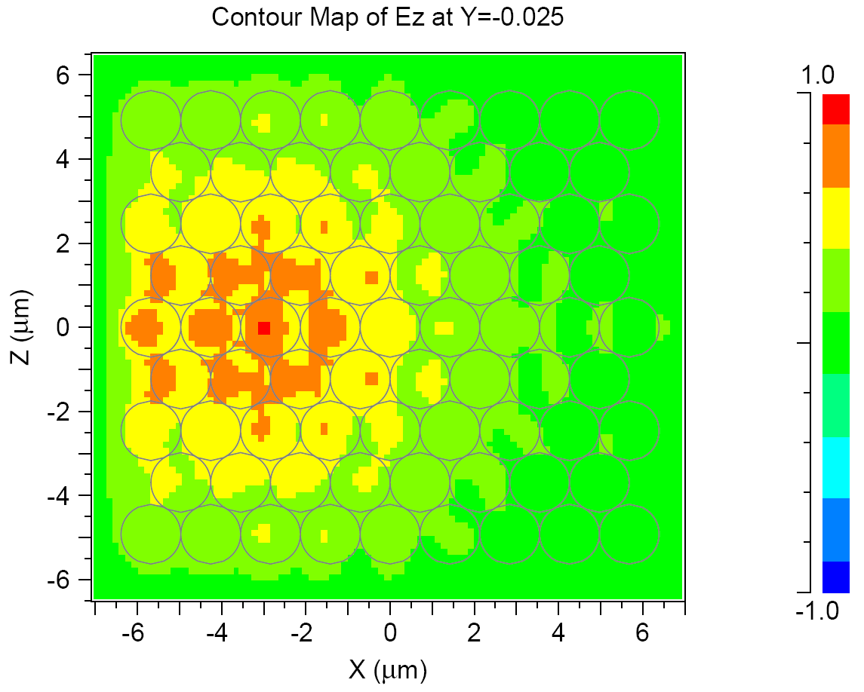
FDTD calculations
λ/d=1.1
dip
λ/d=1.2
Notes:
Full vector FDTD calculations of the light coupling into the monolayer of dielectric spheres with n=1.42, d=1.42 µm. Normally incident excitation field is polarized in z-direction and has a Gaussian profile with the (1/e field) width w0=5 µm centered at x=-3 µm

Slide 10
a-Si covered monolayers
Transmission spectrum:
Main dip deepens and red shifts with increasing thickness
Multiple dips appear
L. Landström, D. Brodoceanu, N. Arnold, K. Piglmayer and D. Bäuerle, Appl. Phys. A. 81, 911 (2005).

Slide 11
Relation to photonic crystals
ML with the overlayer = photonic crystal slab (PCS) with high contrast (like inverted opal) (3<n_{Si}<5)
Dip = diffracted wave couples to the mode
Multiple modes  multiple dips
Normal incidence: θ=0  dips corresponds to the ω∝ d/ λ of the lowest modes at the center (Γ-point) of the Brillouin zone in the (multi-valued) frequency surface ω(k)
Confined modes – periodic in-plane, evanescent in z-direction – no good software  use supercells, filter out folded modes
b₂
b₁
M
K
a₂
Γ
a₁

Slide 12
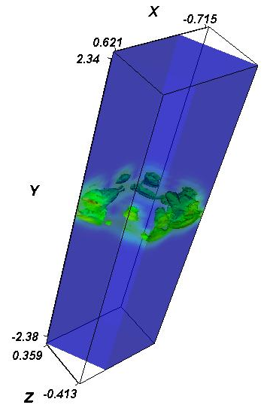
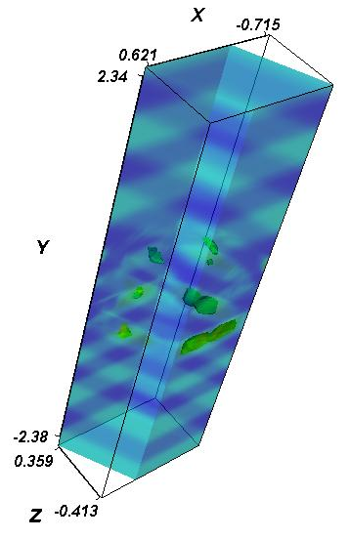
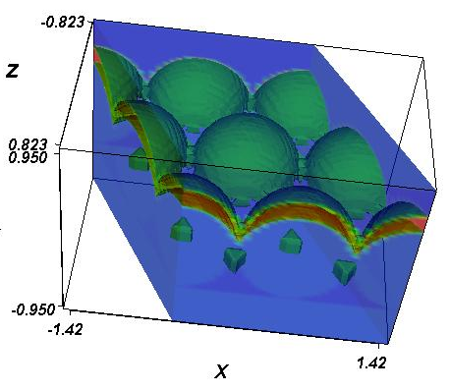
Computational scheme
Supercell 5d in z-direction
Modes at Γ-point
# 20 true
# 22 folded
Smoothened ε profile
Plane wave expansion
Deposit – shifted spheres
h/d=0.2, support included
True vs. folded modes:
Structure
Si-confinement  h-dependence
Supercell dependence, number

Slide 13
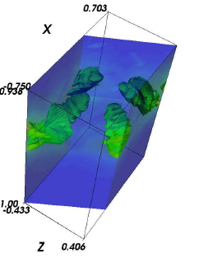
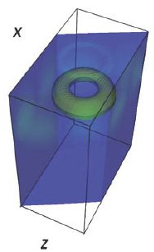
Dependence on the overlayer thickness
Estimation with n_{eff}
Squares – experimental dip positions
L. Landström, N. Arnold, D. Brodoceanu, K. Piglmayer and D. Bäuerle, Appl. Phys. A. 83, 271 (2006).
Notes:
Frequencies of the lowest modes at Γ -point as functions of a-Si deposit thickness h. Only
confined (not folded) modes are shown. Dotted curve – estimation from (2) (at normal incidence θ = 0)
and (3). Experimental points are deduced from the dips (solid squares) and maxima (open circles) in the
transmission curves for the microspheres with d = 1.42 μm. nSiO2 = 1.35 and 1.42 were taken for the
spheres and support, respectively, nSi = 3.3 for the a-Si layer of thickness h was used
Only true modes are shown

Slide 14
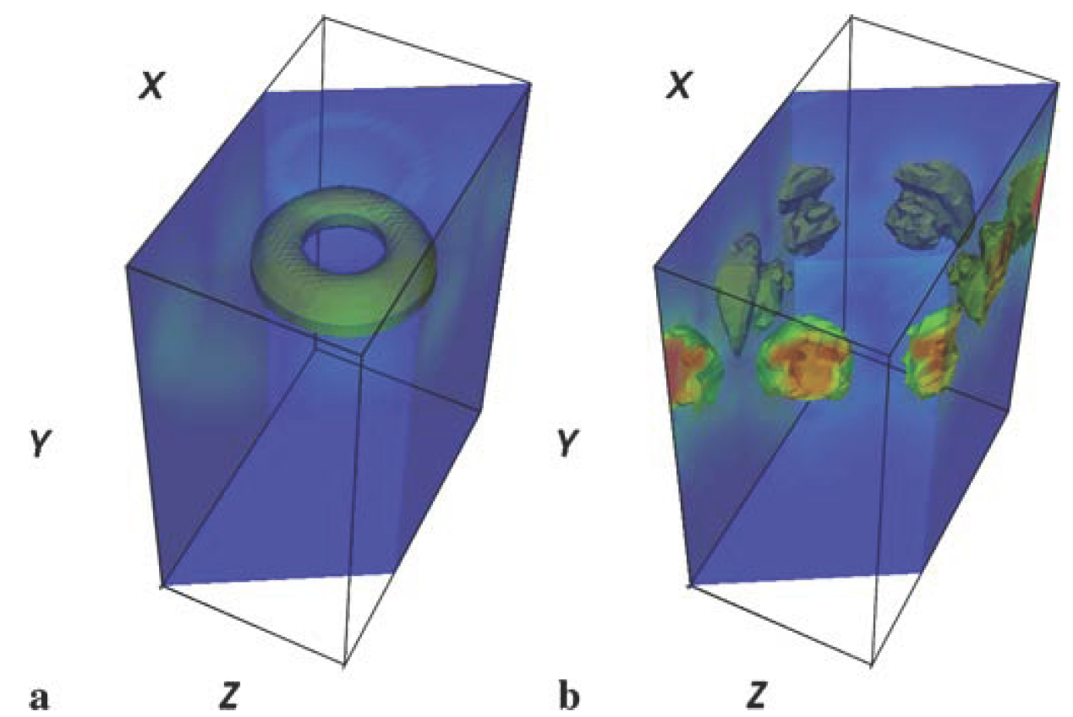
Mode profiles
Modes are mainly in Si deposit (larger n)
h/d=0.175
Lowest “donut” mode
From lowest ML mode at h=0, has azimuthal E structure
Weak coupling (FDTD)
“Main dip” mode
6-fold symmetry
Good coupling into 6 waves
Notes:
Distribution of intensity EE∗ in two of the modes at the Γ -point. Deposit thickness
h = 0.175d. (a) Donut mode; (b) The mode tentatively responsible for the most pronounced dip in
transmission. Other parameters are as in Fig. 4

Slide 15
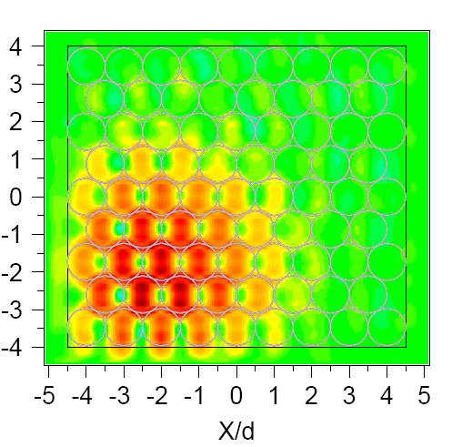
FDTD coupling
λ/d=1.87
donut
λ/d=1.54
Measured dip
λ/d=1.24
Measured maximum
h/d=0.175, n_{SiO2}=1.35, spheres, n_{glass}=1.42, n_{Si}=3.3
E_{z} ↕ (incident) component shown
Dip is broad in λ, several coupling modes
Notes:
Full vector FDTD calculations of the light coupling into the monolayer of dielectric spheres
of thickness d on the quartz support (nquartz = 1.35 and 1.42 was taken for the spheres and
support, respectively). nSi = 3.3 for the deposited a-Si layer of thickness h was used. Normally
incident Gaussian beam has half-width (1/e field) w0 = 2.5d , is centered at x = −2d, z = −2d,
and is polarized in z-direction. Ez component is shown everywhere. a) h = 0, λ/d = 0.75. b)
h/d = 0.175, λ /d = 1.87 , donut mode, see FIG. 4a. c) h/d = 0.175, λ /d = 1.54, main measured
dip, see FIGS. 1, 3 and 4b. d) h/d = 0.175, λ /d = 1.22, measured transmission peak, see FIGS. 1
and 3.

Slide 16
Effective refractive index
Main dip position: n_{eff}↑  ω~d/λ_{dip}↓
n(λ) neglected here
Estimation with n_{eff}
Notes:
Frequencies of the lowest modes at Γ -point as functions of a-Si deposit thickness h. Only
confined (not folded) modes are shown. Dotted curve – estimation from (2) (at normal incidence θ = 0)
and (3). Experimental points are deduced from the dips (solid squares) and maxima (open circles) in the
transmission curves for the microspheres with d = 1.42 μm. nSiO2 = 1.35 and 1.42 were taken for the
spheres and support, respectively, nSi = 3.3 for the a-Si layer of thickness h was used
Only true modes are shown

Slide 17
Oblique incidence
Main dip splits in two
Different directions describe frequency surface dispersion ω(k) near the Γ-point
Non-idealities:
ML domains ~100 μm, non-polarized light  orientation averaging
Various sizes, defects, 3<n_{Si}<5
Coupling coefficients
Simplified n_{eff} description
Γ point
Notes:
Changes in zero-order
transmission with the angle of incidence
θ. a-Si deposit thickness h = 0.11d with d = 1.42 μm. The points
in the inset (squares) are deduced
from the transmission dip positions
in the main plot. Transmission curves
are shifted in y-scale for convenience

Slide 18
Orientation-dependent coupling
Main dip mode. Use n_{eff} near Γ-point (normal incidence)
Different directions (φ_{kb} angle) describe frequency surface dispersion ω(k)
Observed transmission is averaged over different orientations φ and polarizations
φ
Notes:
FDTD calculations of the light coupling into composite monolayer. Material parameters
as in Fig. 2. Field component corresponding to the polarization of incident Gaussian beam ( or ↔) is
shown at y = 0.5d (top of the spheres). Beam with half-width (1/e field) w0 = 2.5d centered at x =−2d,
z=−2d and at x =−2d, z = 0 for (c). (a) Normal incidence, h/d = 0.175 and λ/d = 1.54. This corresponds
to the main measured dip seen in Fig. 1. Its h dependence is shown in Fig. 2 and the responsible
mode in Fig. 3b. (b) Same as (a) but for λ/d = 1.22, corresponding to transmission maximum seen in
Figs. 1 and 2. (c) Oblique incidence (θ = π/6 in x–y plane). h/d = 0.11 and λ/d = 1.6. Diffraction on
b vector with ϕ = π is responsible for the lowest dashed curve in the inset in Fig. 5. (d) Same as (c) but
λ/d = 1.23. Strong diffraction on 2 b vectors with ϕ=±π/2 is responsible for the upper curve in Fig. 5
(inset)

Slide 19
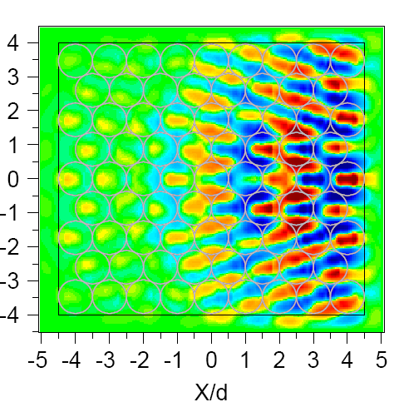
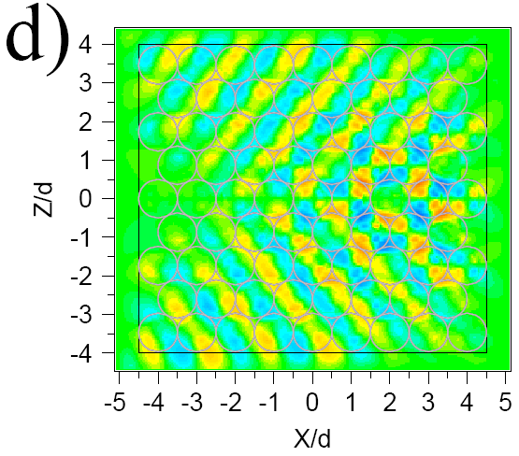
FDTD coupling and polarization
θ=π/6, h/d=0.11
φ=π/2, strong
φ=π/2, weaker
λ/d=1.23, E_{x} ↔ shown
Better coupling to k_{s} ⊥ E
Dipole effect
Note change in mode period
φ=π, strong
φ=5π/6, weaker
λ/d=1.6, E_{z} ↕ shown
Notes:
Full vector FDTD calculations of the light coupling for oblique incidence θ = π /6 in
x − y plane. Beam center is at x = 2d, z = 0 and h/d = 0.11. Other parameters as in FIG. 2. a)
λ/d = 1.23, p-polarization, Ex component. Strong diffraction on 2 mathbfb vectors with φ = ±π/2
corresponds to the upper curve in the inset in FIG. 5. b) λ /d = 1.23, s-polarization. Ex-component
of the field results from the scattering on the spheres light couples into the same modes as in
a), albeit somewhat weaker. c) λ /d = 1.6, s-polarization, Ez component. Strong diffraction on
mathbfb vector with φ = π. d) λ /d = 1.6, p-polarization, Ez component. Diffraction on 2 mathbfb
vectors with φ = ±5 π /6 (s-polarization couples even stronger). Cases c) and d) correspond to two
lower curves in the inset in FIG. 5.

Slide 20
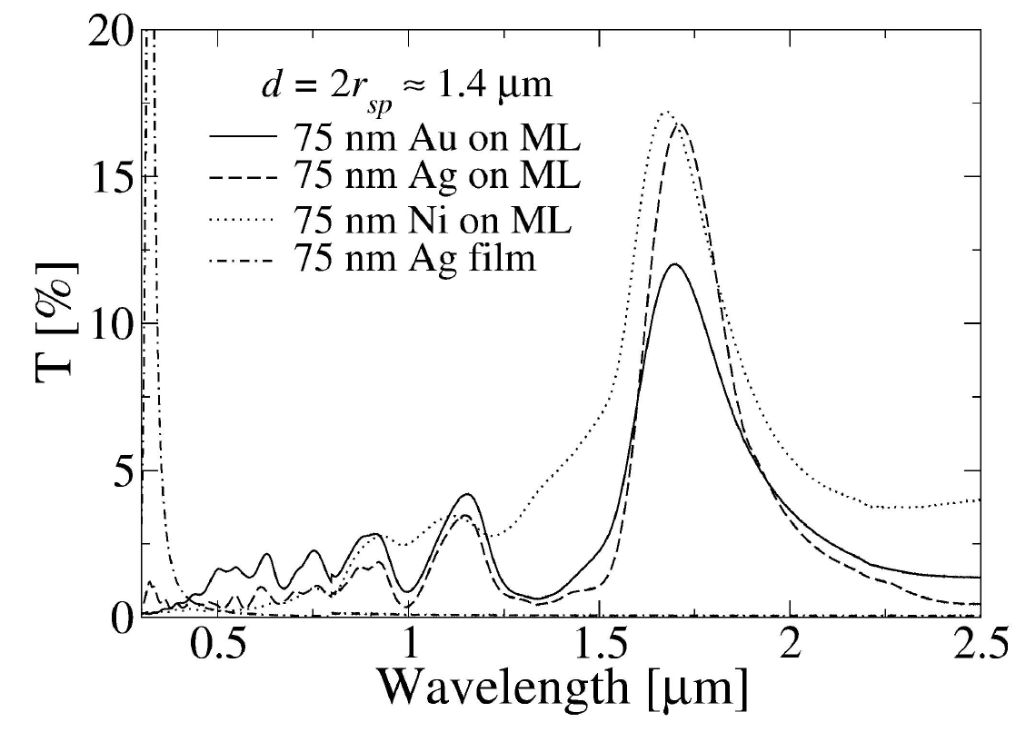
Metal-covered monolayers
Transmission spectrum:
Metal independent
Bare monolayer minima become maxima
Slightly red shifted
Positions thickness independent
high T values (compare dash and dash-dot)
λ_{max} scales with d 1st maximum: d/λ~1.18
L. Landström, D. Brodoceanu, K. Piglmayer, G. Langer and D. Bäuerle, Appl. Phys. A. 81, 15 (2005).
Notes:
Transmission spectra measured at normal incidence for monolayers of a-SiO2 microspheres
(d ≈ 1.4 μm) coated with different metals. The dash-dotted curve shows the spectrum for
a 75 nm thick Ag film on a plane a-SiO2 substrate

Slide 21
Minimal model
Question: Why metal transmits?
Metals: Re ε<0, FDTD requires 200 points/λ
Time consuming ⇒ minimal model – Metallic Fabry-Perot
t₂₃
3, air
r₂₃
2, metal
t₁₂
r₂₁
1, monolayer n_{mon}
Standard FP, but:
Evanescent waves
In and out coupling by diffraction: t⁰¹ means from 0 to 1st order, etc.
1
2
3
E_{i}
E_{t}
E_{r}
E_{c}
h
L. Martín-Moreno, F.J. García-Vidal, H.J. Lezec, P.M. Pellerin, T. Thio, J.B. Pendry, T.W. Ebbesen, Phys. Rev. Lett. 86, 1114 (2001).

Slide 22
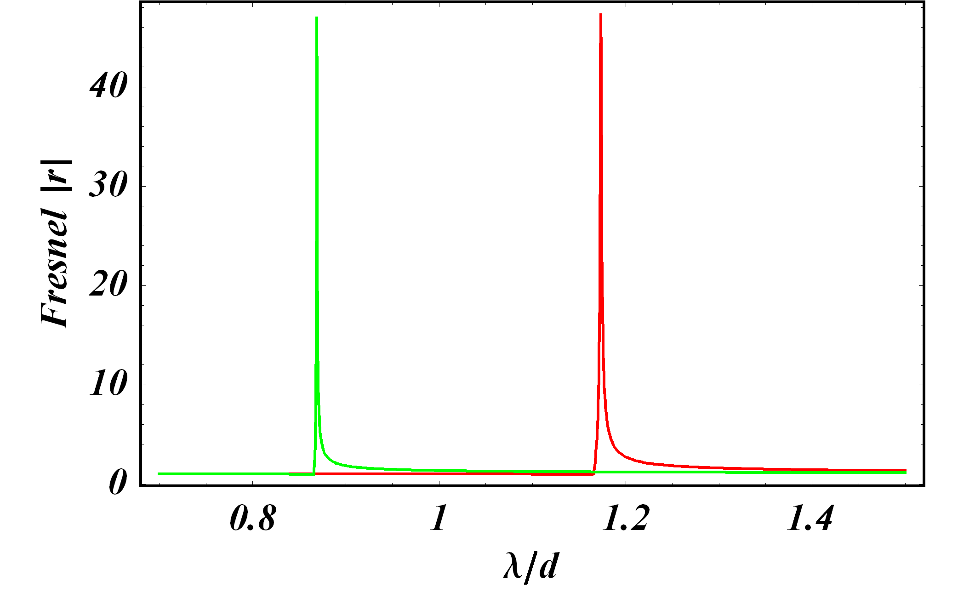
Resonant FP denominator
evanescent
Transmission large when denominator small
Can happen despite exponential term
For evanescent waves Fresnel coefficient r>>1 is possible
p-polarization
metal-air
metal-monolayer
ε₂=ε_{metal}=-143.75+12i (~Ag)
ε₃=ε_{air}=1 and ε₁=ε_{mon}=1.81

Slide 23
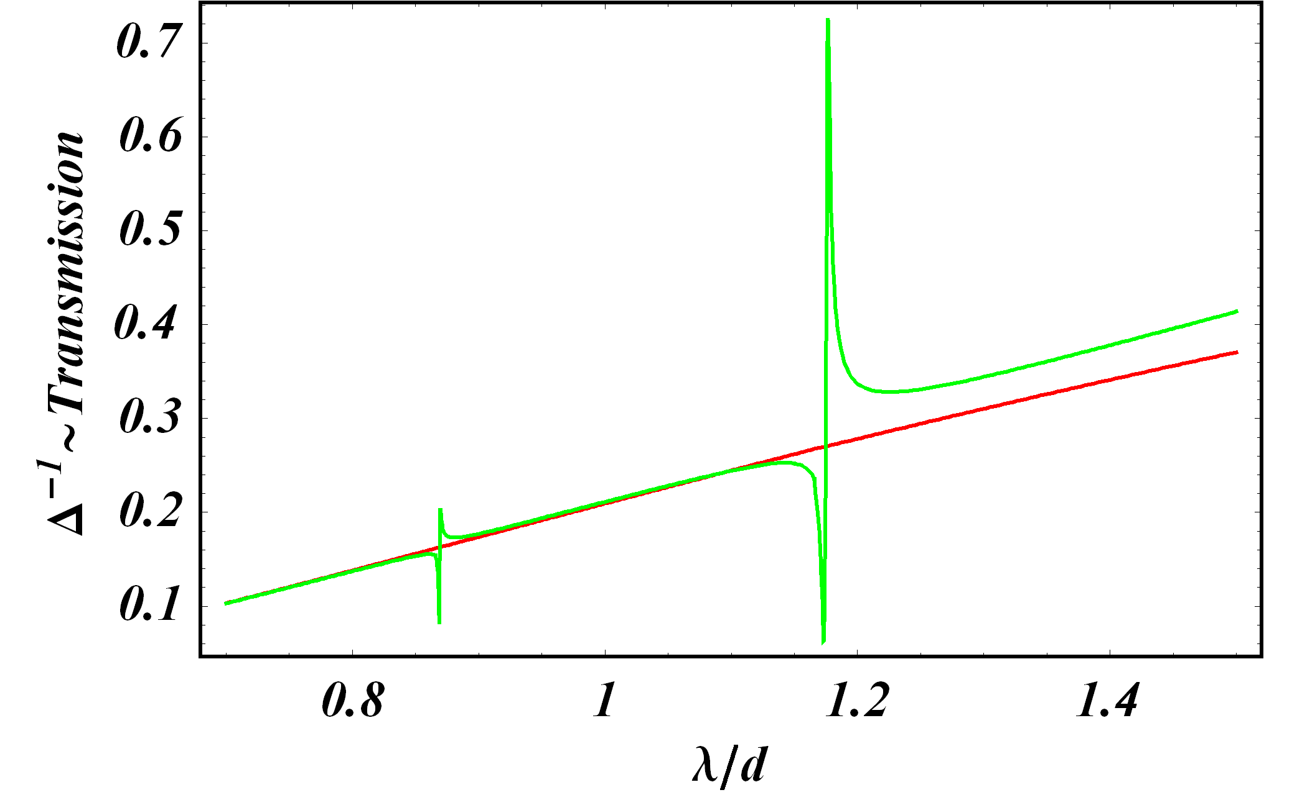
Qualitative transmission (denominator)⁻¹
Ag, h=30 nm
Main maximum-metal-monolayer
p-polarization
s-polarization
For quantitative description:
Many modes together
Coupling coefficients t difficult
Better FDTD

Slide 24
Plasmons and minima to maxima inversion
Resonant r>>1 condition <≈> surface plasmon on the interface
1st order diffraction, normal incidence, metal-monolayer interface
Almost = bare ML dip condition
Upper part of the ML contains no air 
filling f=0.8>0.6  n_{mon}↑  λ_{dip}↑ 
minima become maxima that are red shifted (λ/d=1.18 vs. 1.12) (holds for SiO₂ and PS spheres)

Slide 25
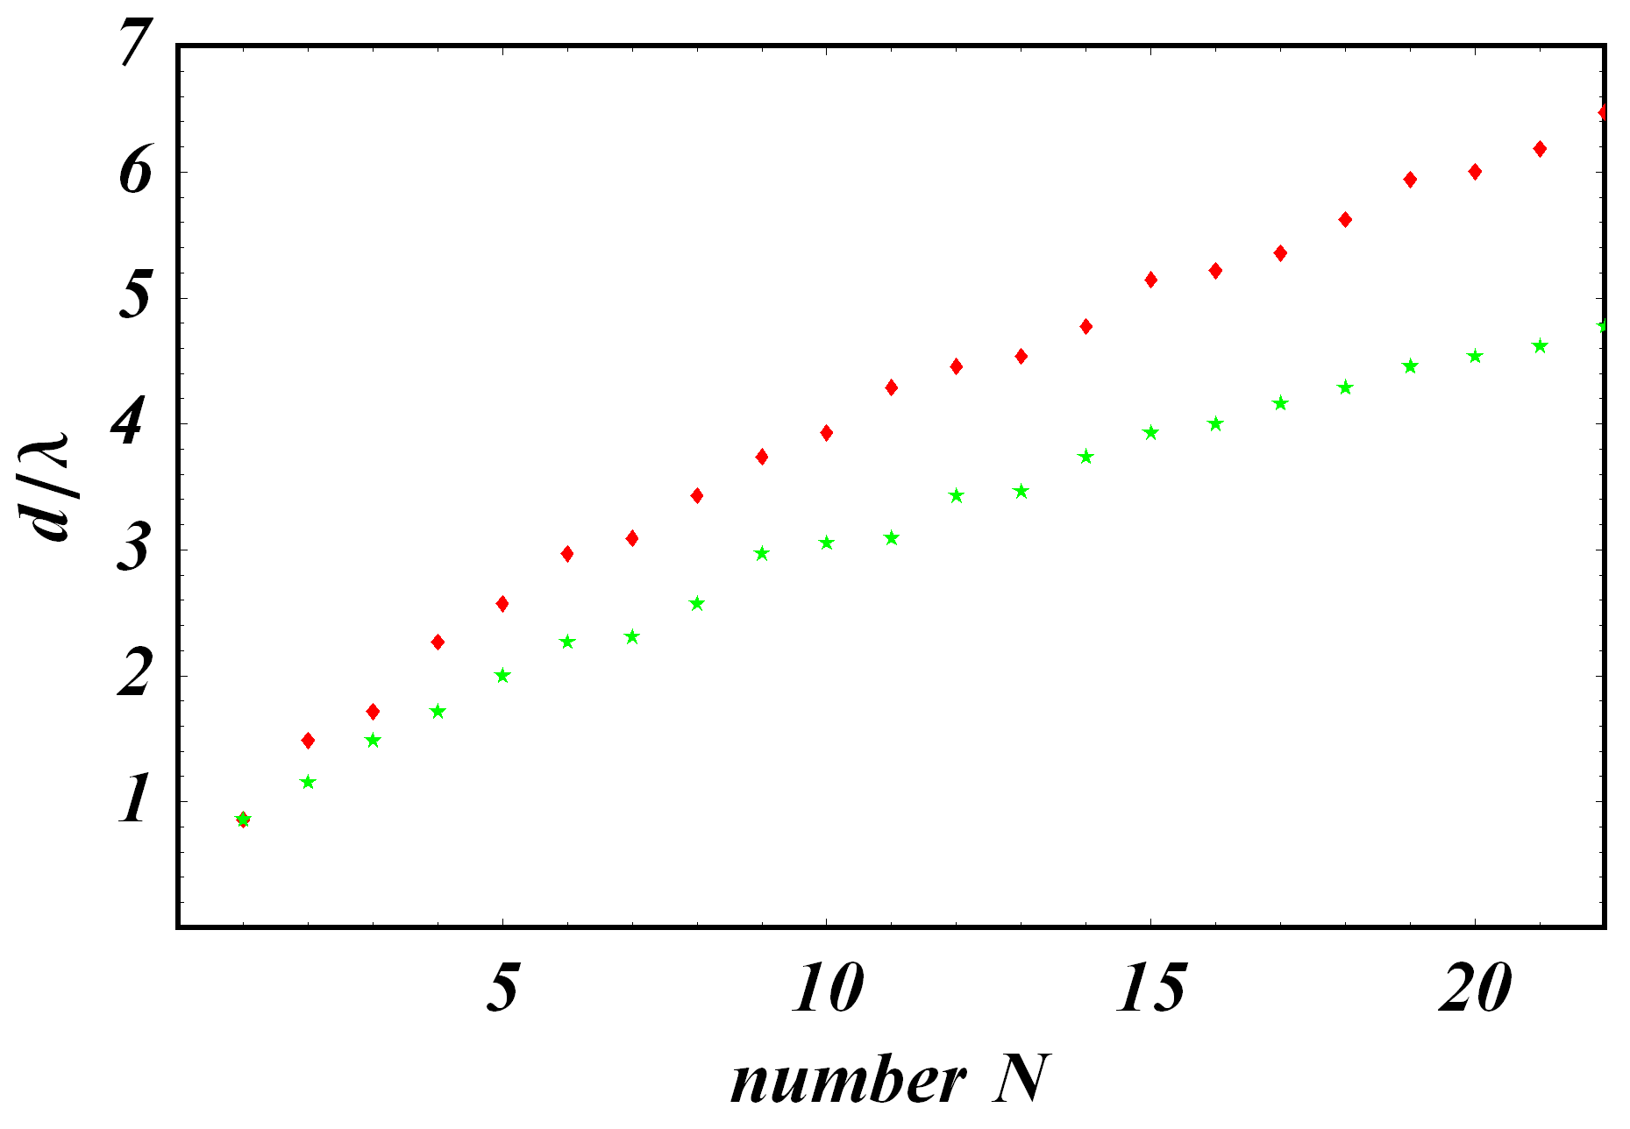
Multiple maxima positions
Oblique incidence, higher order diffraction:
Normal incidence, Ag
Maxima are broad, overlap
Orientation averaging
All ε depend on λ
Coupling coeffs. t differ
Difficult to say if metal-air interface plays a role
metal-monolayer
metal-monolayer and metal-air

Slide 26
Interesting experimental question
Does one need the holes in the metal to see extraordinary transmission?
Or film modulation alone is enough?
The (qualitative) theoretical answer:– it shall work without holes
Difficult to verify (smaller efficiency, cracks)

Slide 27
Acknowledgements
Prof. D. Bäuerle
Dr. L. Landström
Dr. K. Piglmayer
CD Laboratory for Surface Optics
Univ. Doz. Dr. K. Hingerl
MSc. J. Zarbakhsh
Funding:
Austrian Science Fund (FWF), P16133-N08

